Slide 1
Guided-Inquiry Learning in a Large-lecture Setting
Guang Jin, P.E., Sc.D.
Tom Bierma, MBA, Ph.D.
Environmental Health Program
Department of Health Sciences

Slide 2
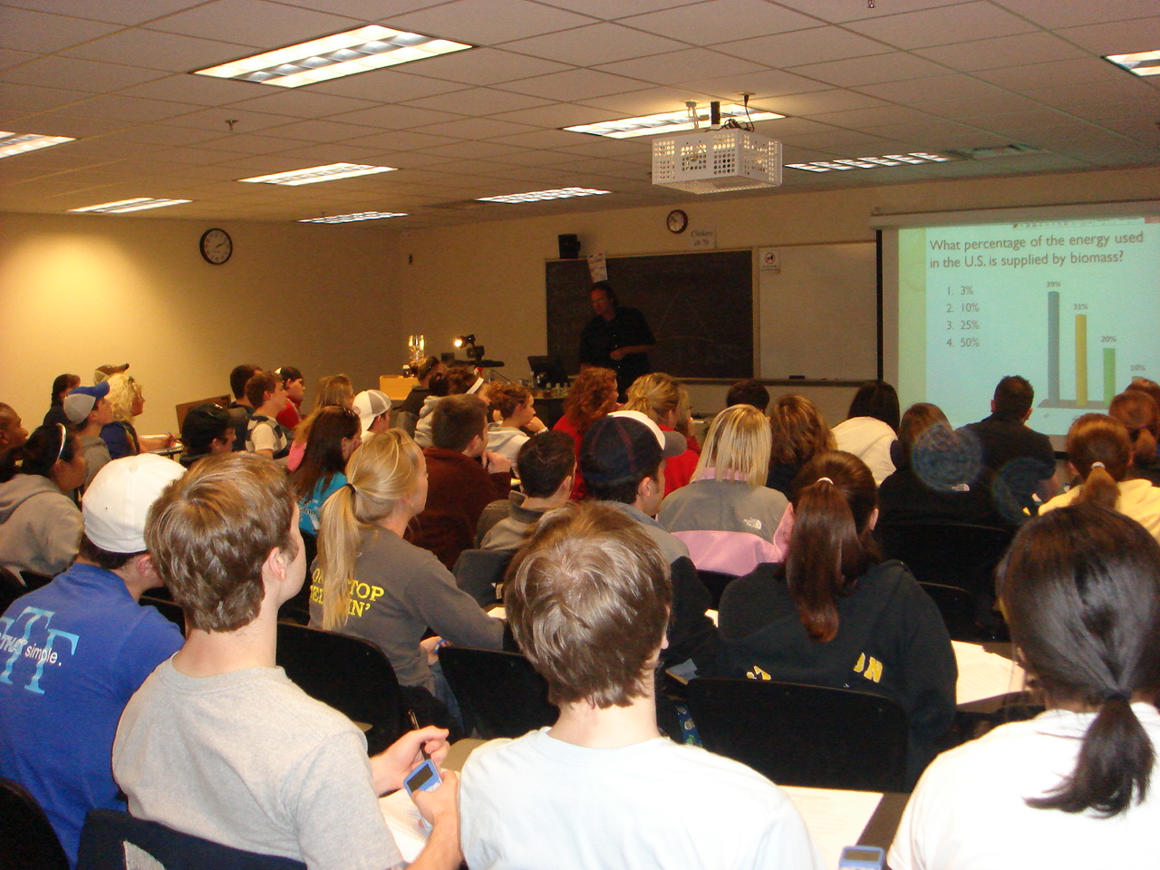
The setting…
HSC 156, Environmental Health in the 21st Century (80-200 students per class)

Slide 3
The problem…
Abstract concepts disengage students
Examples:
Development of pesticide resistance
Bioenergy

Slide 4
Objective
Increase student engagement, learning autonomy, and understanding…
When presenting abstract concepts.

Slide 5
Guided-Inquiry Learning
Essentially the scientific process…
Recognize a problem, formulate a question.
Collect data
Examine data for patterns that help “discover” an answer to question.

Slide 6
POGIL
Process-oriented Guided-inquiry Learning
Originated in chemistry education
Group process (downplayed in our work)
Guided-inquiry process

Slide 7
POGIL
Premise…
(supported by POGIL research)
Students are more engaged and have a better understanding when they are involved in inquiry and “discovery.”

Slide 8
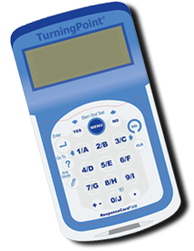
Clickers used to allow two-way communication.

Slide 9
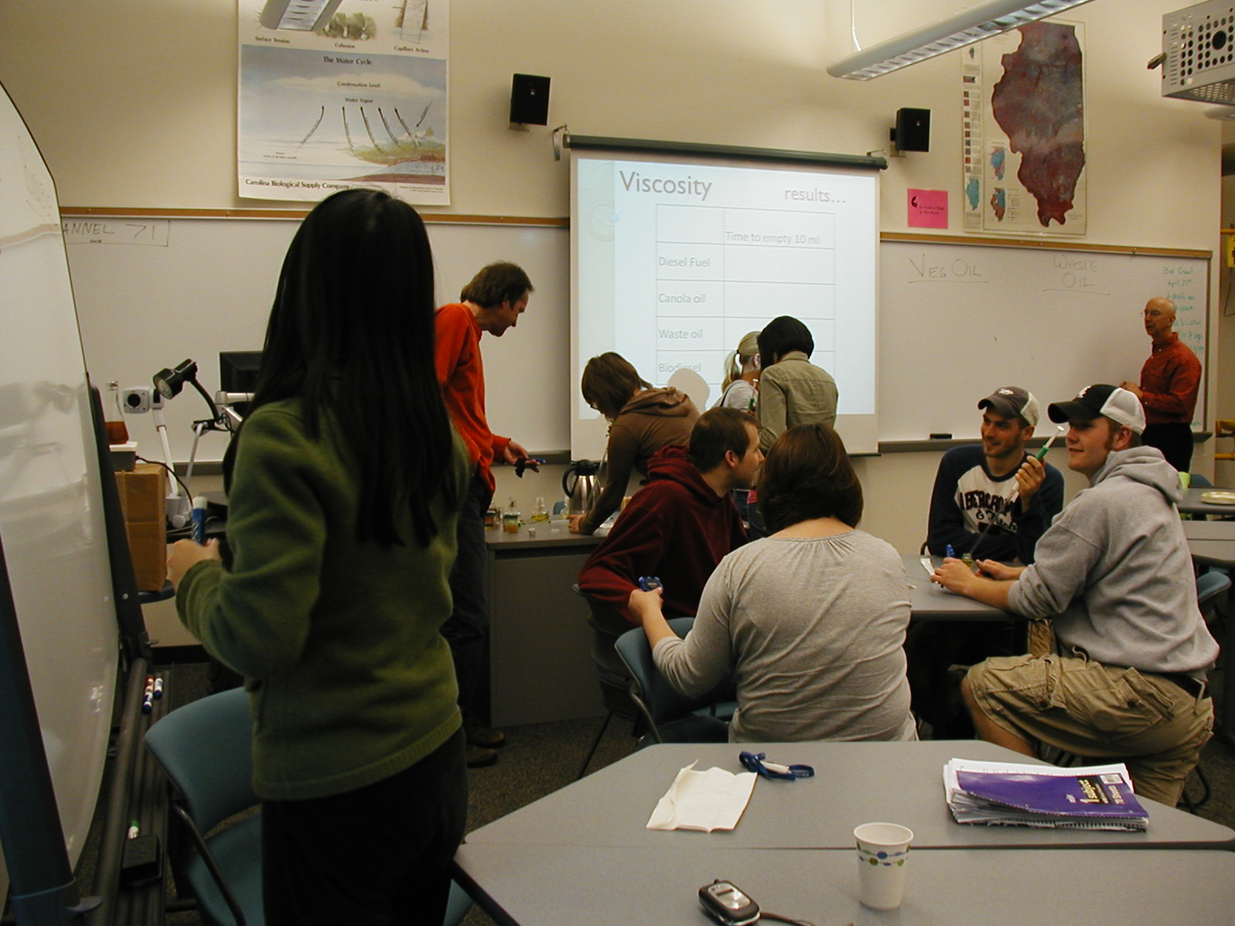
Pre-test modules on small group

Slide 10
Module 1
Development of pesticide resistance
“How do pest populations become resistant to pesticides?”
“What are the implications for farmers?”
“How might resistance be minimized?”

Slide 11
Concepts to be “discovered.”
Population resistance evolves from population diversity and stresses from the environment (pesticides)
Rate of resistance development increases with pesticide application level.
Pesticide application only buys time, doesn’t solve problem.

Slide 12
Part 1 - manipulatives
Use pieces of paper to create a pest population with diverse pesticide tolerances.
Eliminate the susceptible individuals.
Let the rest reproduce
What do you discover?

Slide 13


Continuing….
30
50
Let’s assume you find two “pests” in your field.
One has a “pesticide tolerance” of 30 and the other a pesticide tolerance of 50.
A pesticide tolerance of 30 means that a pest cannot survive when pesticide is applied at a level of greater than 30
Use a small piece of paper to represent each of these pests. Write their pesticide tolerance on the paper.
50
30

Slide 14
Your pests evolution should look like…..
1st Gen.
30
50
2nd Gen.
45
50
55
3rd Gen.
45
50
55
50
55
60

Slide 15
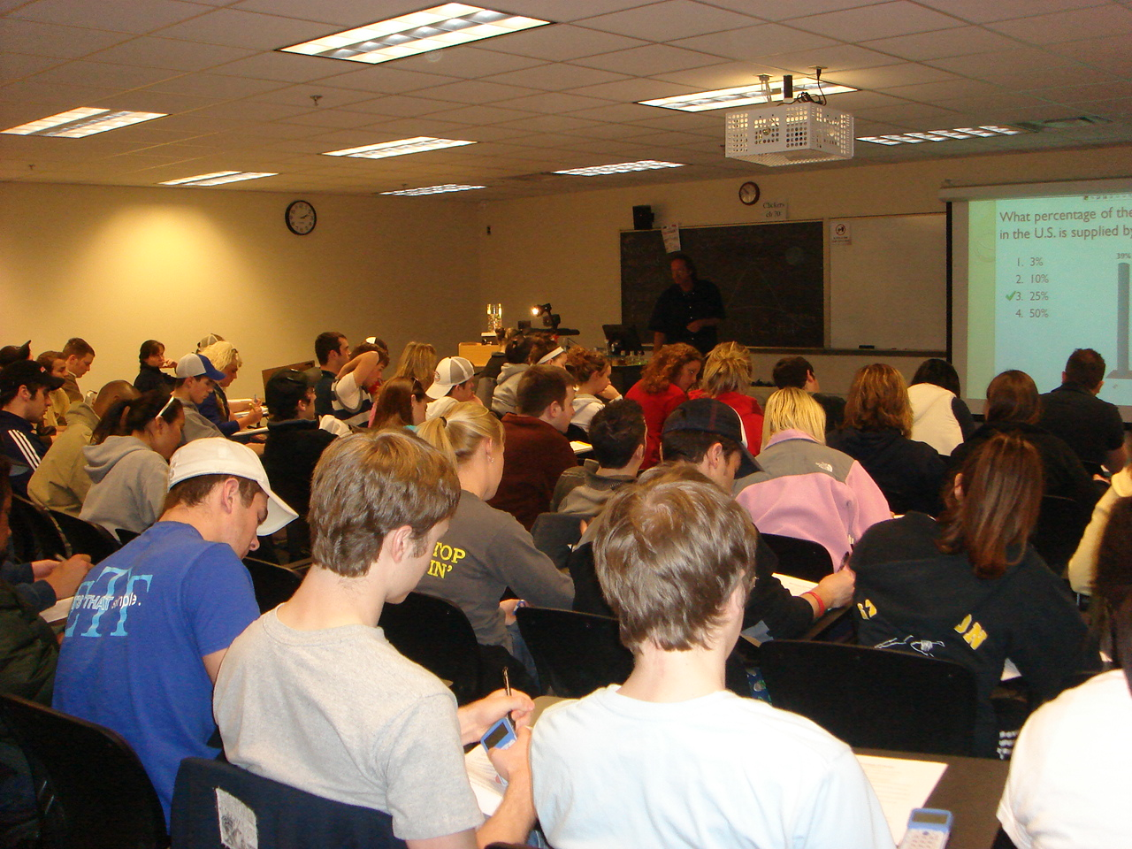
Working in informal groups

Slide 16
Part 2 – computer simulation
Computer simulates paper exercise but faster and on a larger scale.
Students can vote on simulation inputs using clickers.
Simulation output helps students see patterns.

Slide 17
What new pesticide dose should we try?
10
30
70
95

Slide 18
Pesticide applied
No pesticide

Slide 20
Module 1I
Bioenergy
“Can bioenergy contribute to solving U.S. energy problems?”
“Can bioenergy contribute to solving global warming?”
“How can science help bioenergy become practical?”

Slide 21
Concepts to be “discovered.”
Energy flows from sunlight, to chemical energy in plants, to heat in an engine.
The energy molecules in plants can be altered to better suit our fuel needs.
Science can be used understand, evaluate, and improve bioenergy sources.

Slide 22
Make biodiesel from waste fryer oil in class
What is waste fryer oil?

Slide 23
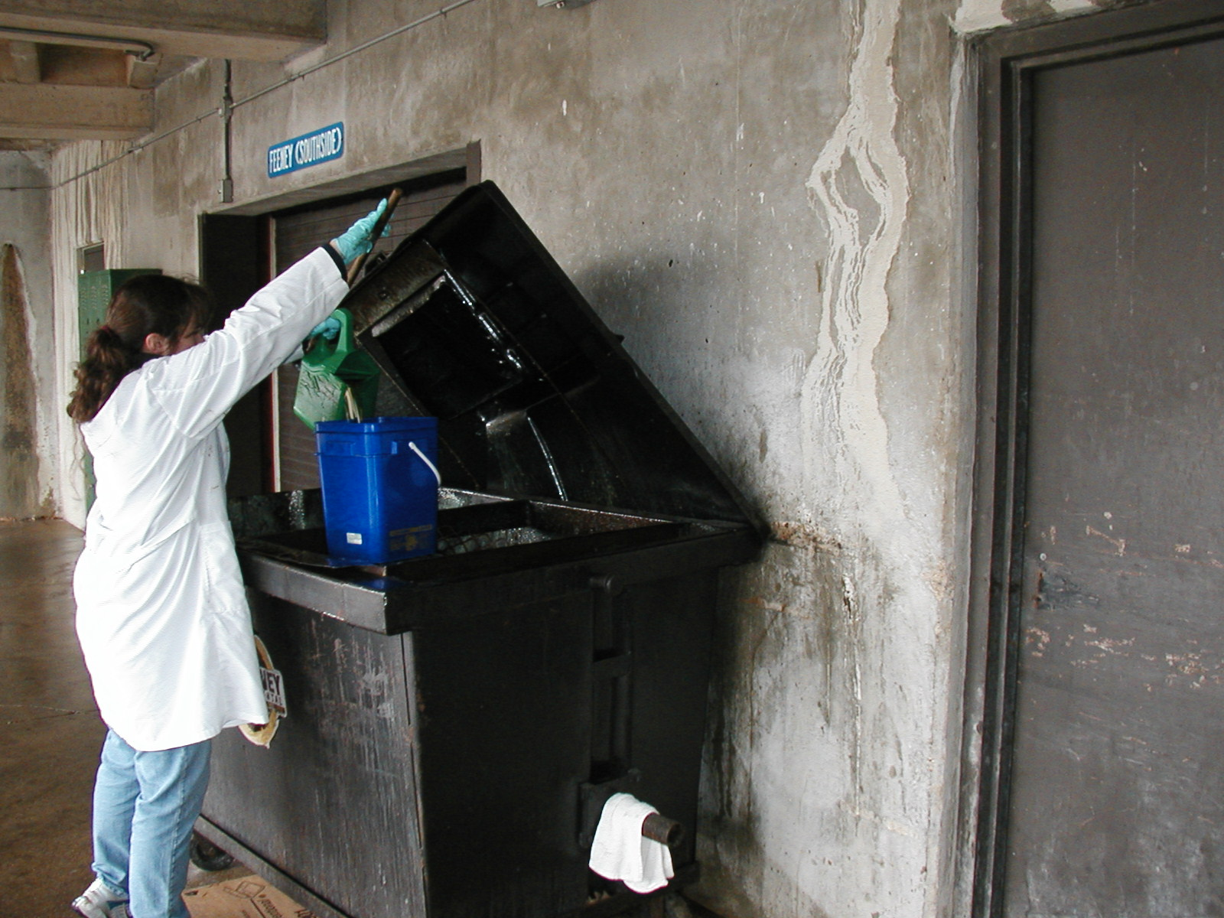

Slide 24
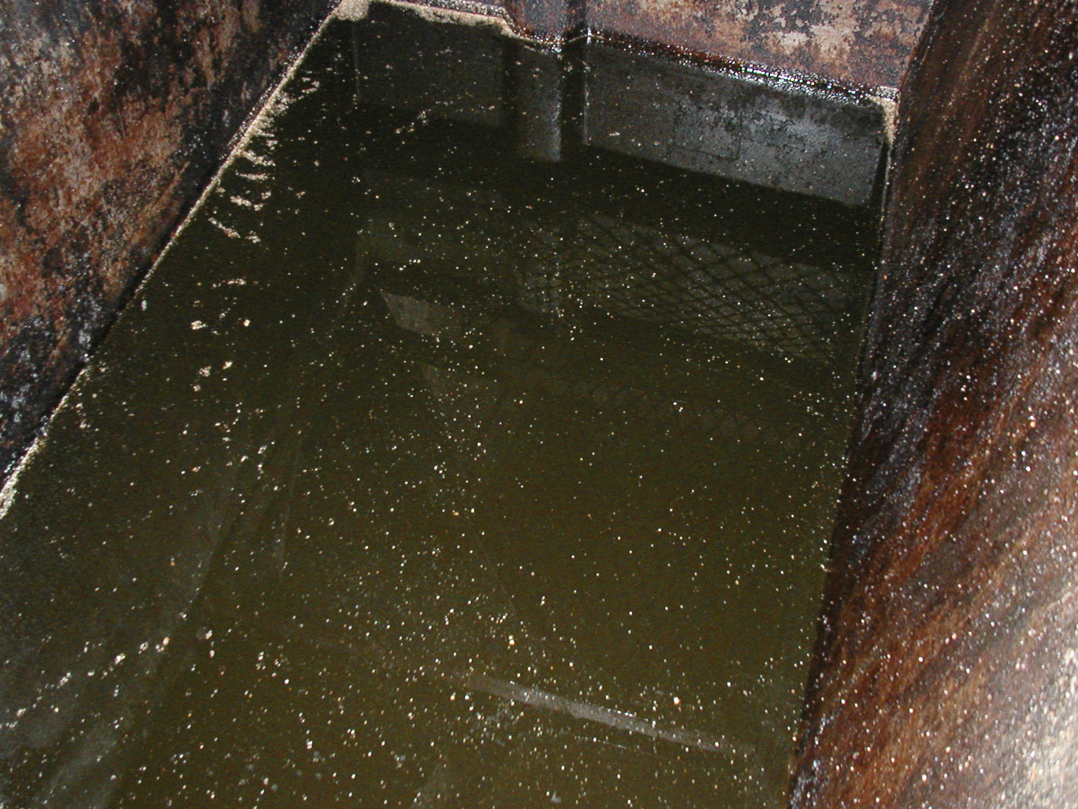

Slide 25

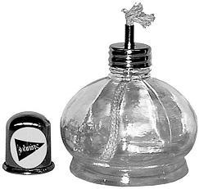
Will it burn?
Will it work in a diesel engine?
Too viscous!

Slide 26
How can we reduce it’s viscosity but preserve it’s fuel value?
Can we alter the molecule?
Carbon chains

Slide 27
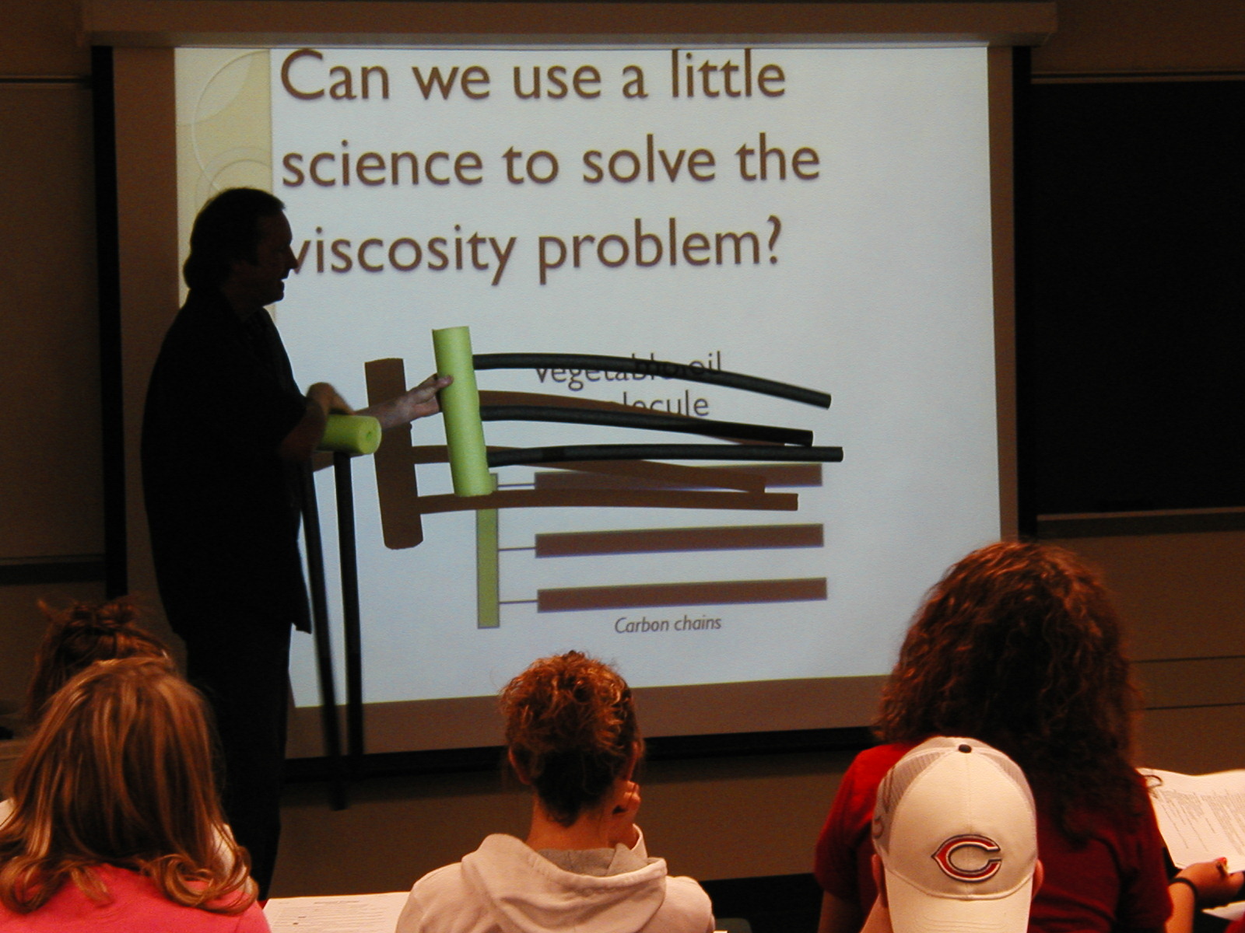

Slide 28
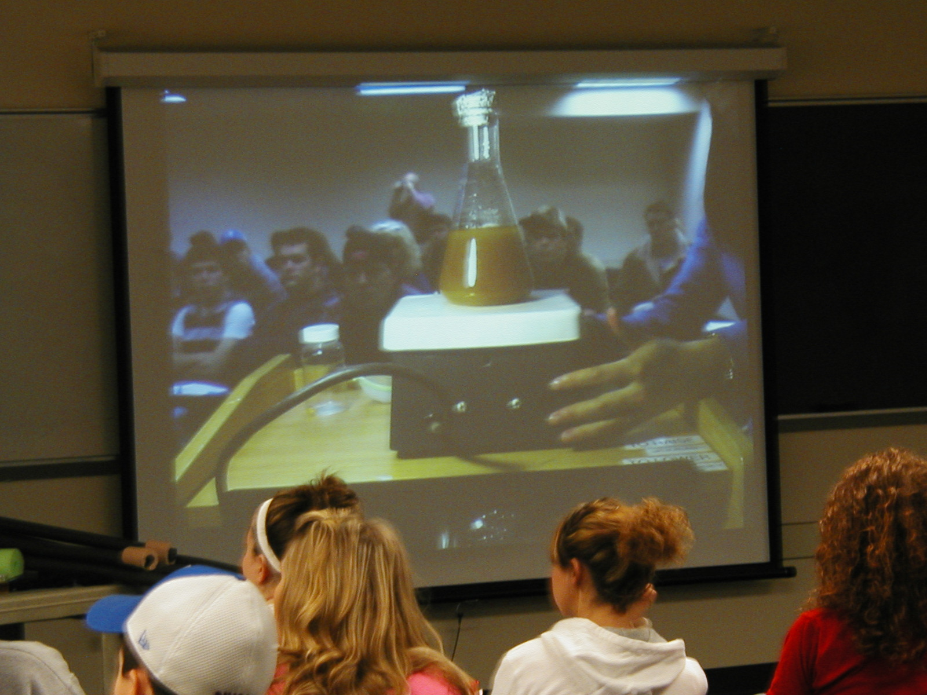

Slide 29
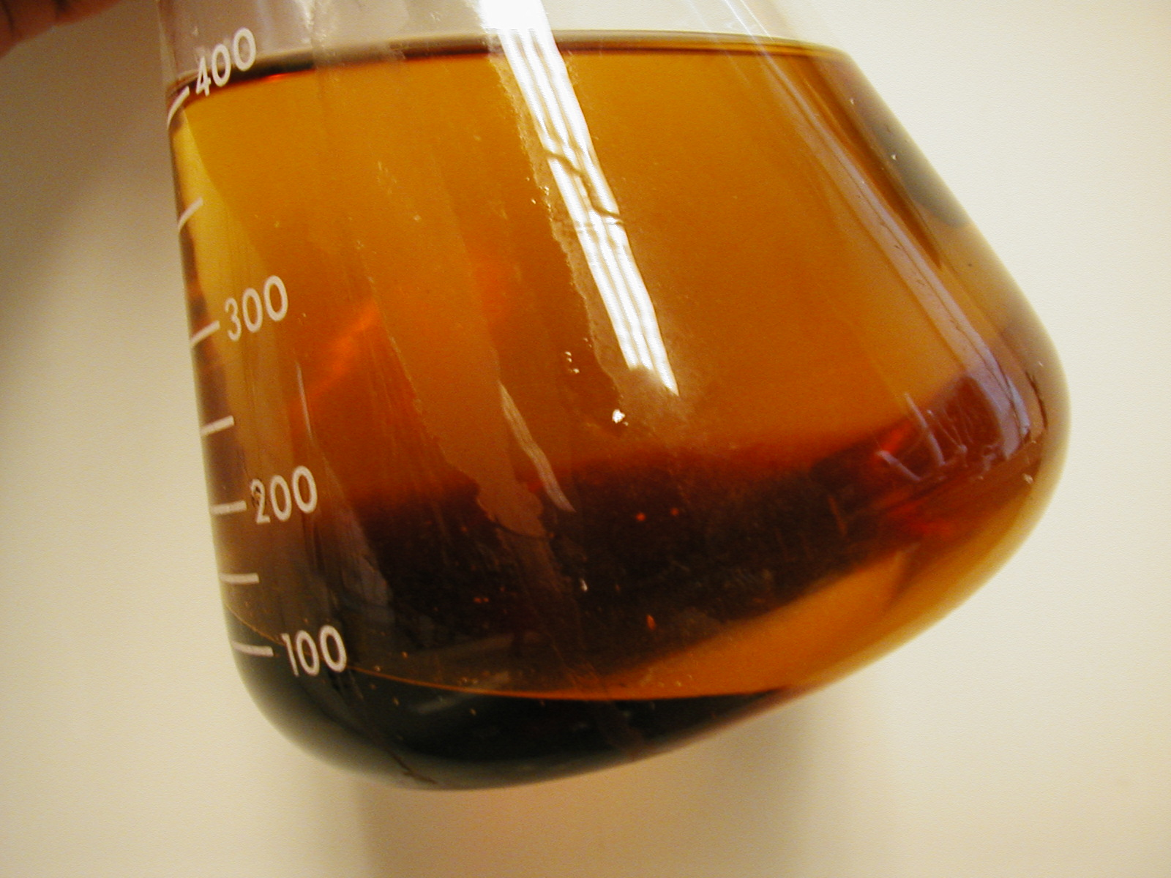

Slide 30
How can we tell if the product will have the right viscosity?
Can we do an experiment?
Biodiesel

Slide 31
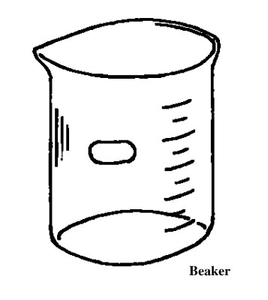
Viscosity given these objects…
Pipette
Biodiesel
Stop watch
How could we test the viscosity of biodiesel?
How would we know if it flows well enough?

Slide 32
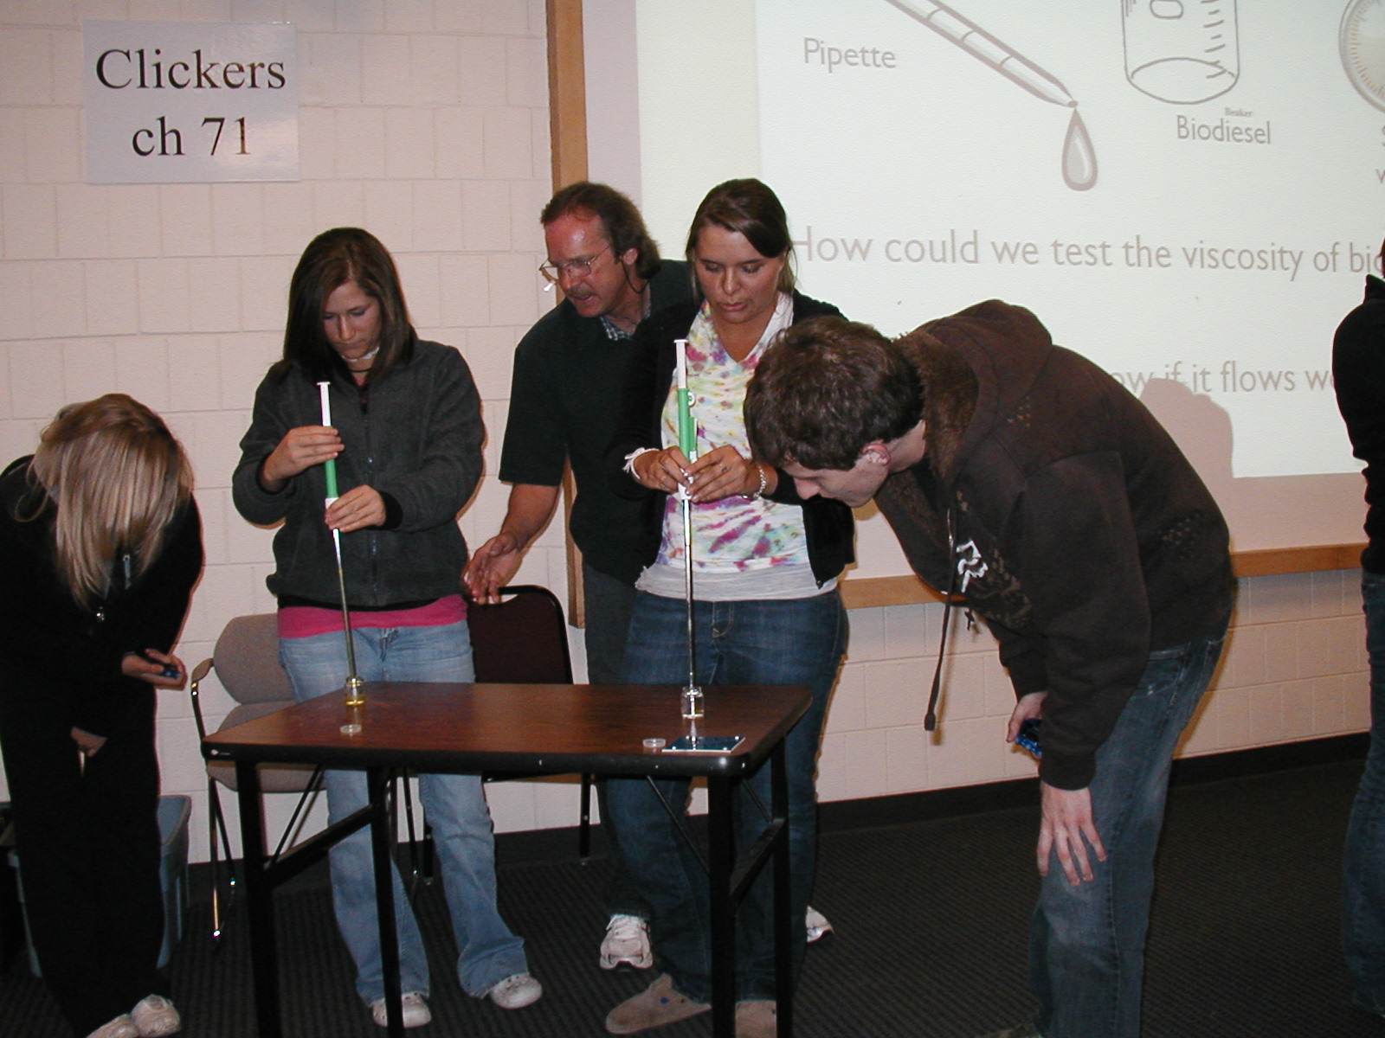

Slide 33
How can we tell if it burns well?
Can we do an experiment?
Biodiesel

Slide 34
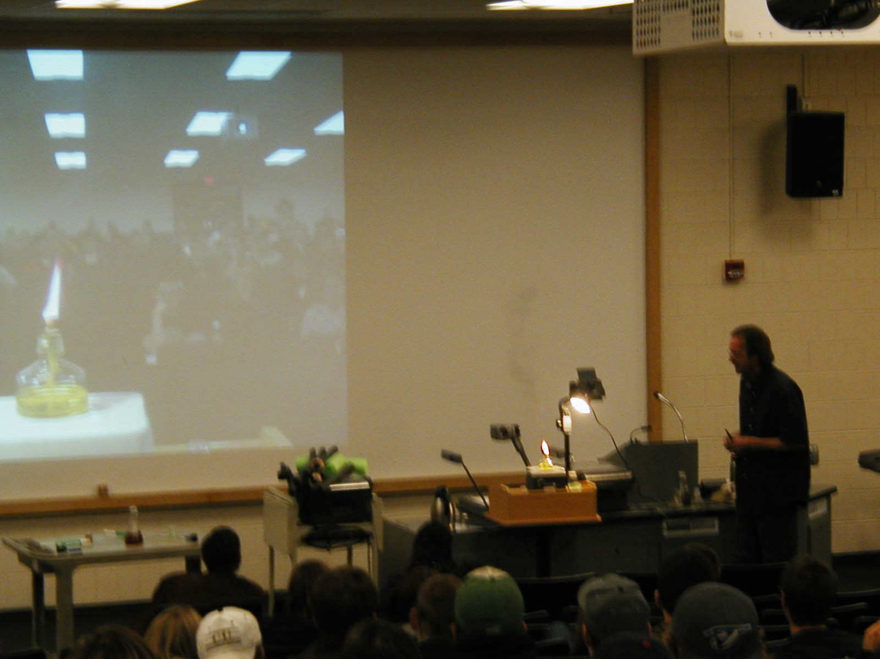

Slide 35
Results
Greater student engagement and attention.
Positive student feedback.
Slightly better performance on exam and quiz questions, although not statistically significant.

Slide 36
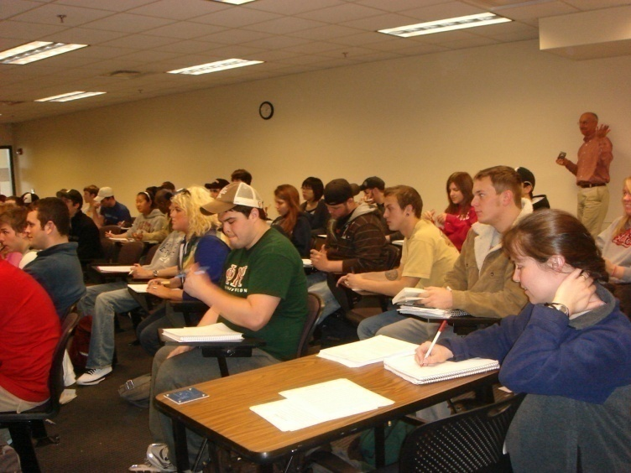
Greater Engagement and Attention
more active discussion among students, more relevant questions raised during class, and more additional questions after class.
a dramatic decrease in distracted behavior and increase in attentive behavior.
Our teaching assistant Lucy Loftus doing class observations
Notes:
Our teaching assistant noticed distracted behavior (looking at the ceiling, clock, newspaper, cell phone, etc.)
(facing forward or engaging in the class activity)

Slide 37
Positive Student Feedback
Notes:
through anonymous clicker response. At the following class meeting, students were asked to respond to the following two questions: 1) “The pesticide (or bioenergy) activity we performed last class helped make the material in this unit more interesting.” and Q2: “The pesticide (bioenergy) activity we performed last class helped me better understand some of the concepts in this unit.” Students used their clicker to respond with “strongly agree”, “agree”, “neutral”, “disagree” or “strongly disagree”.

Slide 38
Positive Student Feedback

Slide 39
Impact on Learning Outcome

Slide 40
Conclusions
The guided-inquiry learning modules appear to be more effective than traditional teaching methods in engaging students.
Students also clearly enjoyed the activity more, and believed that it helped them understand the concepts better.
More enjoyable for the instructors!

Slide 41
Conclusions
More time consuming, both in terms of creating the module and implementing it.
To use primarily when teaching complex or abstract concepts that students typically have trouble comprehending.

