Slide 1
Enabling Critical Thinking Skills that Sustain Learning for a Lifetime
David T. Marx
Physics Department
10th Annual University-Wide Symposium on Teaching and Learning
Wednesday, January 6, 2010

Slide 2
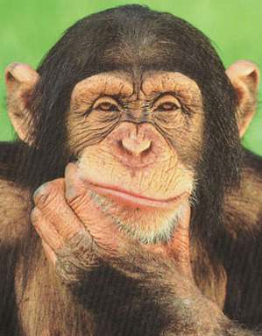
Definition: Critical Thinking
a skill
a mental process
a behavior / attitude
Skill
cognitive skills in interpretation, analysis, evaluation, inference, explanation, synthesis, and self-regulation
We would like these skills to be applicable to a variety of contexts – but rarely does this work in practice.

Slide 3
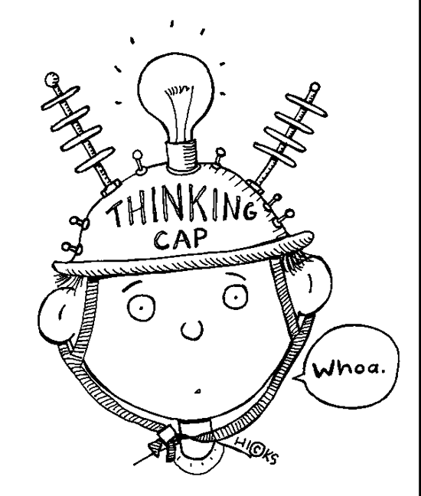
Definition: Critical Thinking
a skill
a mental process
a behavior / attitude
Mental Processes
Includes: classifying, evaluating, observing, synthesizing, and extrapolating
An observer (nor even the subject) cannot determine what mental processes are happening. The product is what is evaluated and important.

Slide 4
Definition: Critical Thinking
a skill
a mental process
a behavior / attitude
Behavior / Attitude
Critical thinking requires one to choose to do it. It’s hard work. One has to have to right attitude.
Tasks we seek to do are often difficult to do - Try and Succeed – Try and Fail – or Don’t try at all.

Slide 5
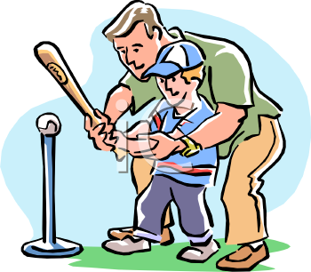
Critical Thinking
What we can do…
Teach Concepts to provide the foundation and the background for learning.
Give direction
Motivate
Enable students to make their own choices, to come to their own conclusions, and to form their own opinions.

Slide 6
Critical Thinking
Rationality
Decisions based on information available
Doesn’t rely on authority
Knowledge must be true
Beliefs can be true or false
The majority opinion may be wrong.

Slide 7
Physics General Education Courses
Physics 102:
Atoms to Galaxies
Physics 207:
Energy & Climate Change
Interactive Engagement
Clickers
Check-in Questions
Peer Instruction
Surveys
Small Group Exercises
Homework
Semester-long Project

Slide 8
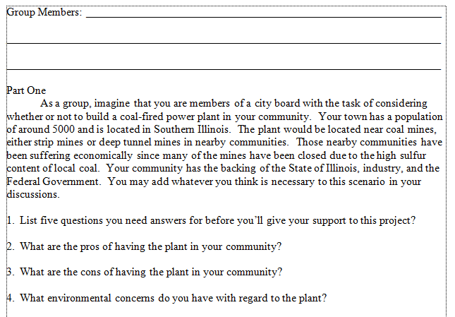

Slide 9
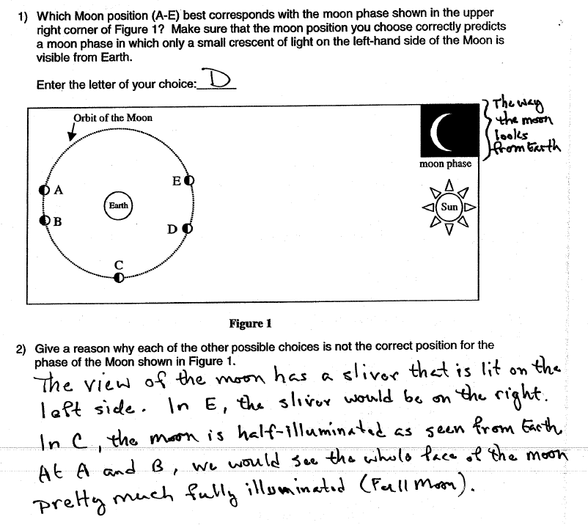

Slide 10
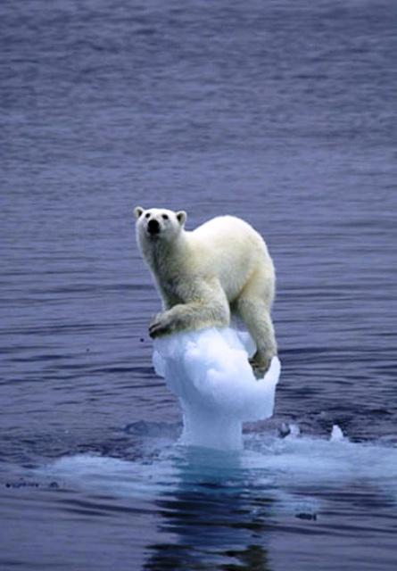
Physics 207: Fall 2009
Class Project on Global Warming
What are “greenhouse” gases? What are the quantities of these gases from both anthropogenic and natural sources?
Learn about the activity of the Sun, including sun spots, energy output, and solar flares. How has the energy output of the Sun varied over time? How does the energy output of the sun affect temperatures on the Earth?

Slide 11
3a. Your first objective in this assignment is to seek out reliable data on the area and thickness (if available) of ice at the poles. You may not use Wikipedia for this. There are websites that give regular updates on this data and also give some degree of historic data. We want only primary sources for this assignment. No secondary sources will be accepted. You can use published data in peer‐reviewed scientific journals or the kind of websites described above.
Write about what you find, comment on the information, provide figures that you find that support your findings.
3b. Learn about the Earth’s climate history, including estimates of the Earth’s temperature during these eras. In the history of the Earth, it has undergone eras of ice (ice ages) and eras of extreme heat that resulted in mass extinctions. Find out about this and write in detail about it and provide any figures that back up the information you find. For this, you can use secondary sources, including Wikipedia, because finding primary sources for this is very hard. Secondary sources take the information generated by primary sources and synthesize the information to tell a more complete story.

Slide 12
In this assignment, we’ll examine the historic temperature data that is being used to determine whether the earth as a whole is warming. Modern temperature data is gathered by satellites (since 1979) and by a network of thermometers. But historic temperature data is harder to come by and has a significant error associated with it. For this assignment you’ll be going only to primary sources for this data (no news articles, no commentary articles, no Wikipedia, etc.) – we only want peer‐reviewed articles written by the scientists that made the measurements or analyzed the data or the database websites such as those listed below.
Go to the following websites and learn about the datasets that are there and look for historical temperature data. Find out how the data is collected and what, if anything, is done to the raw data before the data is finalized. Look for historic land, sea, and atmospheric temperature data on these sites and copy graphs that are significant to your report and include them in your report. Also, try to find out what the uncertainty is for these measurements.
4b. The historical temperature record has been based on temperature proxies (tree ring data, ice cores, coral etc.) for the time before we had thermometers. Look into the peer‐reviewed publications about temperatures proxies. Put any temperature data you find into your report, then find out what factors influence these proxies that affect the way we interpret the data.

Slide 13
As a member of the media, I find it discouraging to think that other journalists may have agendas and/or political ties that affect the content of a specific news source. To me this is totally unacceptable. Journalists have a reponsibility to present news, unbiased, to the general public as a service. A lot of the issues of global warming discrepancies involve politics, treaties, and mostly money… even the scientists these days have a bad reputation.

Slide 14
Throughout this paper, I have shown the many instances in which I was shocked upon discovering facts the media and my academic learning of this subject had either failed to mention or skewed to advance the cause of the global warming fight...[I hope this] will lead others to seek out information regarding this topic and not just take what is provided through the mainstream media channels as fact.

