Slide 1
Changing Teaching - Changing Learning
P
articipatory
A
ction
R
esearch: An Experiment in
Political Inquiry
Michaelene Cox
Associate Professor
Dept of Politics and Government

Slide 2
Changing Teaching - Changing Learning
Road Map…
The Experiment:
What is Participatory Action Research?
Why PAR?
How to incorporate?
Who to engage?

Slide 3
Changing Teaching - Changing Learning
What is PAR? Integration!
Connecting academic interests with education and community development
---
Pioneers in PAR
1940s – Present
Multiple approaches but…
Research and Action
must be done
WITH people and
not ON or FOR people

Slide 4
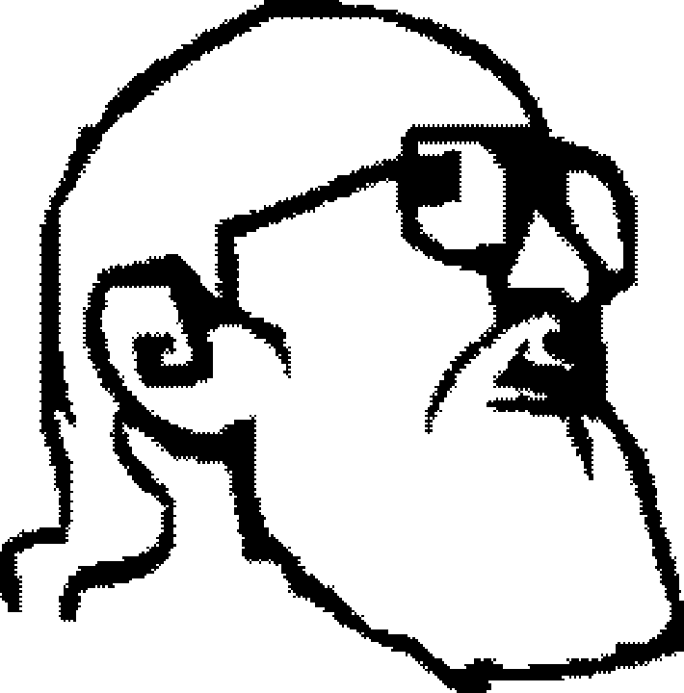
Changing Teaching - Changing Learning
PAR is informed by Critical Pedagogy
Role of Education:
1970
allow learners to regain sense of humanity
recognize pedagogy is a political act
treat learners as co-creators of knowledge
vs. "banking" concept of student, empty object for teacher to fill

Slide 5
Changing Teaching - Changing Learning
What is PAR ? Some features…
Researcher removes biases; becomes an “instrument” or facilitator
Can use multiple forms of data; quant/qual; primary and secondary
Findings typically rich in description

Slide 6
Changing Teaching - Changing Learning
What is PAR ? Some more features…
Stress on process, not product
Ongoing inductive analysis
Data analysis, findings, conclusions provide meaning
Findings inform practice

Slide 7
Changing Teaching - Changing Learning
The Experiment
Why PAR ?
To connect
theory and practice

Slide 8
Changing Teaching - Changing Learning
…Why PAR ?
Address issues; improve situations; make change
Promote professional growth;
develop skills, knowledge base
Promote collaboration; is democratic;
encourage “community”

Slide 9
Changing Teaching - Changing Learning
How to Incorporate ?
Readings on Political Study
- history/current status of the discipline
- inquiry and empirical approaches
- cultural and ethical dimensions
Added application/case readings
IRB training

Slide 10
Changing Teaching - Changing Learning
Next…
We want to make a difference!
Gauged Student Research Interest:
Broad topic: Civic engagement and democracy
Narrow topic: Community service/Volunteerism
Contacted Community Orgs: Red Cross, YWCA
Q: How can orgs best recruit and retain volunteers?
(What are incentives? What are barriers?)

Slide 11
Changing Teaching - Changing Learning
PAR as Problem-Solving
Who to Engage ?
Professor, graduate student teams
Community organizations
Red Cross, YWCA
General public
Collaboration on:
- Thesis question
- Lit review
- Methodology
Interviews
Focus groups
Questionnaires
- Analyses
- Findings/Discussion

Slide 12
Changing Teaching - Changing Learning
The Challenges of PAR
Acknowledging political bias
Making group/collaboration work
Sharing power; encouraging participation
Teaching and learning (practice and skills)
Assessing outcomes

Slide 13
Changing Teaching - Changing Learning
The Results
Academic interests: knowledge building
Educational goals: learning
Community development: capacity building
Lessons Learned from PAR

