Slide 1
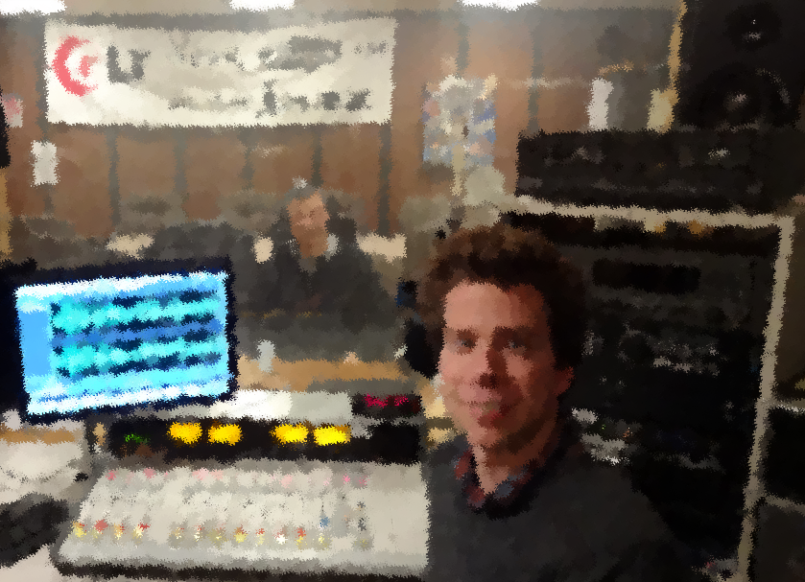
Using podcasts to help students become knowledge-Able in a non-major biology course
Daniel L. Hajek
H. Tak Cheung
2013 CTLT Conference

Slide 2
H. Tak Cheung
Emeritus Professor of Microbiology
Director of School of Biological Sciences
Developer, Instructor, and Originator of
BSC 101
Since 1995

Slide 3
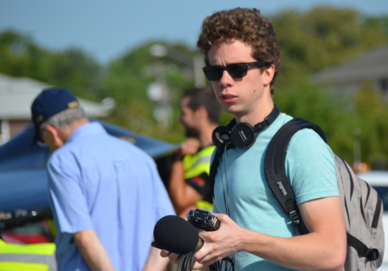
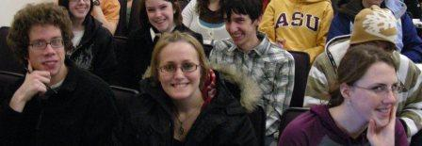
BSC 101 Fundamental Concepts in Biology
General Education Inner Core
Natural Science Sequence
Laboratory course
Annual enrollment – 2,500 students
Lectures (50 min) – twice each week
Laboratory (1 hr 50 min) – once per week

Slide 4
Daniel L. Hajek
Illinois State University Class of 2011
Major in English Studies
Enrolled in BSC 101 Spring 2008
Started work at WGLT in February 2008
Began working as a student announcer
Introduced to NPR programming

Slide 5
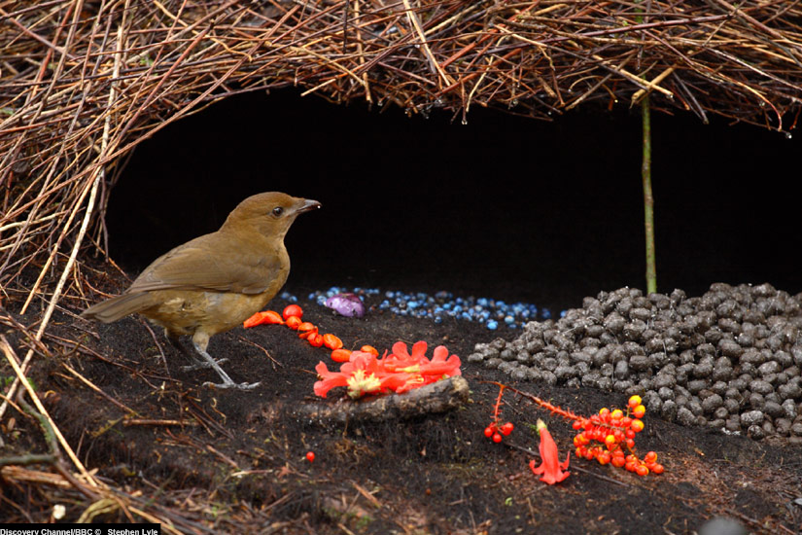
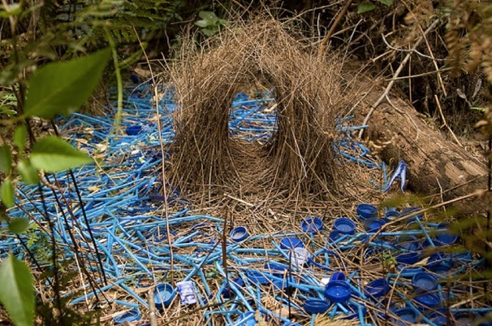
English Project
Assigned to compose an essay emulating our favorite author’s writing style
Produced a podcast segment
Featured Dr. Cheung and a discussion on bower birds

Slide 6
Course Podcast Project
Stories related to topics discussed in class
Interest and curiosity to the students
Relevance and application in everyday life
A student’s perspective on biological topics
Produced in the format of a radio program
Titled “Your Place in the Universe”

Slide 7
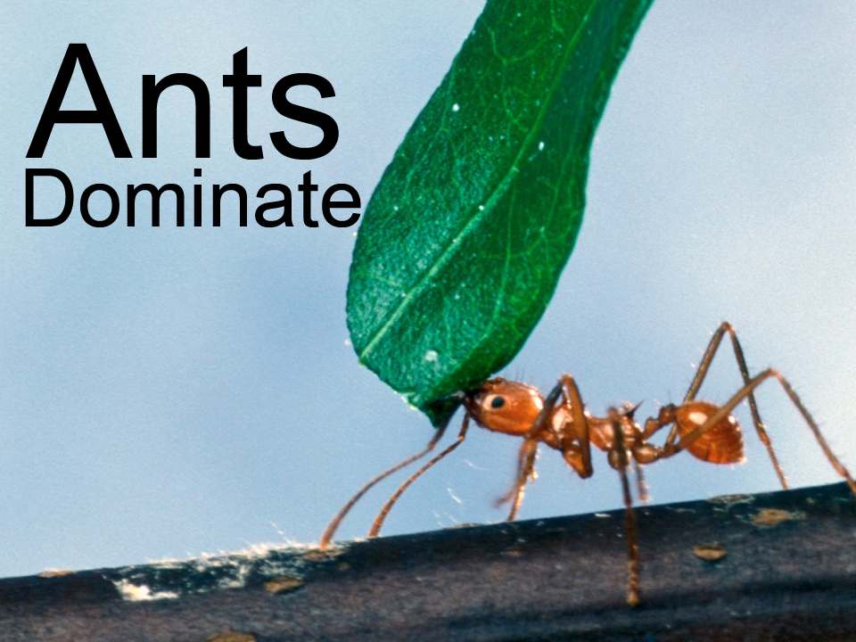

Slide 8
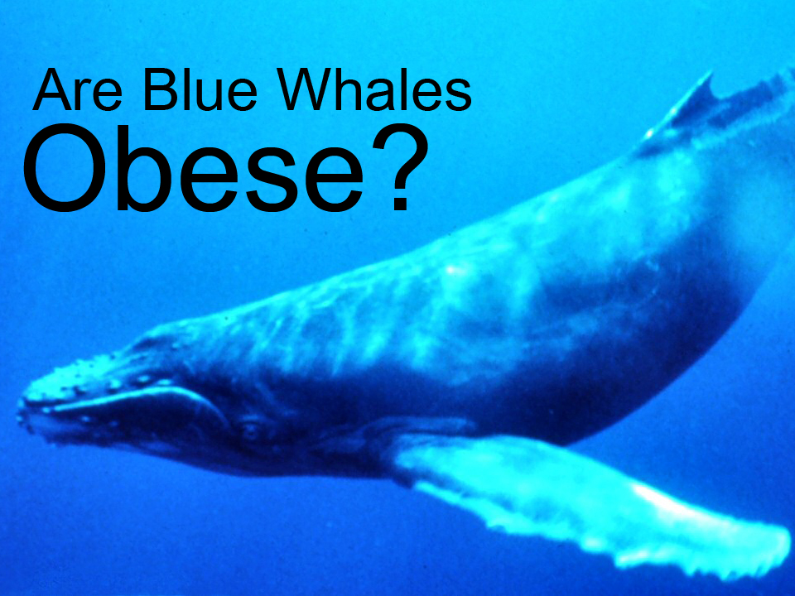

Slide 9
Podcast Production
Interview with Dr. Cheung
Edit down audio clips
Research topics and integrate narration
Incorporate a soundtrack
Uploaded each episode to our website
Monitored user feedback
Produced 15 episodes

Slide 10
Student Feedback
Raised interest in biology topics
Created relevance in biological principles
Found applications in everyday life
Enjoyed having another student discussing biological topics
Podcast preferred to be shorter (<5 to 6 min)

Slide 11
Season Two: Biology Improves Your Life
Designed to correlate with each lecture
Produced two episodes a week
Students were asked to listen to each episode before attending lecture
4-6 min in length
Topics were introduced by stories of interest to students

Slide 12
Podcast Production
Tight production schedule
Collaboration through e-mail
Rapid turn around time
Produced in 3 to 4 hours

Slide 13
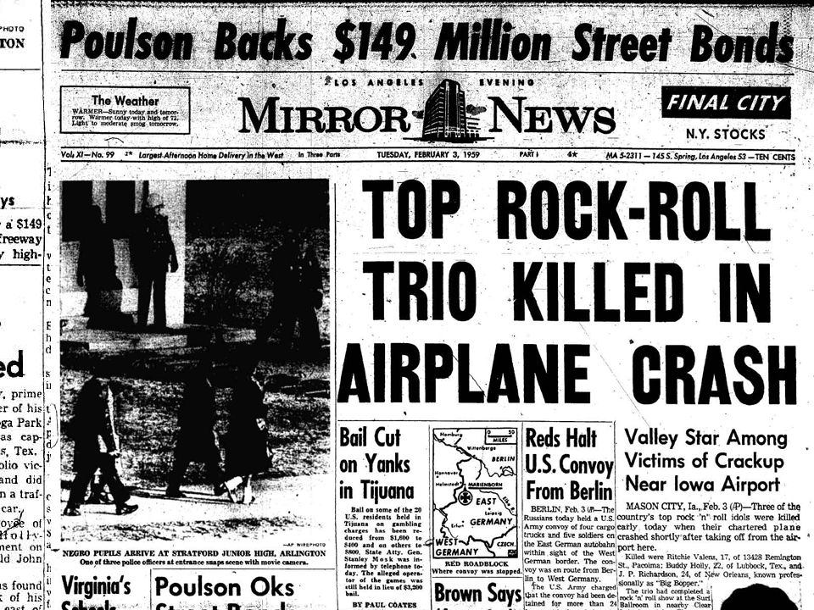

Slide 15
Student Responses
Enjoyed the storytelling approach
Found relevance of the biological concepts through the podcast
Looked forward to the biological explanations provided in lecture
Found the music interesting and stimulating
Appreciated the use of technology embodied in the podcast

Slide 16
NPR Internship
Nationwide selection of internship candidates
NPR-West, Los Angeles, CA
One intern per semester on National Desk
My qualifications
Production experience with biology podcasts
Duties:
Shadow reporters in the field
Help with story research and writing transcripts
In-field recordings

Slide 17
L.A. Votes To Limit Vendors on Venice Boardwalk
All Things Considered
‘Copiale Cipher:’ Mysterious Code Broken At Last
Weekend Edition Sunday

Slide 18
