Slide 1
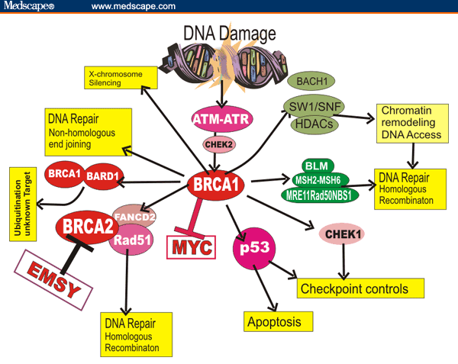
Enhancing Student Participation in a Biology Class by Flipping Instruction
Cynthia J. Moore
School of Biological Sciences, Illinois State University, Normal, IL 61761 – cjmoor1@ilstu.edu
Introduction:
BSC 329, Human Molecular Genetics, is a three credit senior level elective course emphasizing current research. Although demanding, it is one of our most popular senior undergraduate courses, with 30 students enrolled in Fall 2013. I have taught my advanced genetics course in a blended format for three years . Twenty online content modules are substituted for one class session each week.
What’s in the Modules?
All basic content and review materials, illustrated with figures, videos, links and articles.
Self-tests and discussion questions.
Problems with the traditional format:
Diverse levels of prior student knowledge.
Too much lecture needed to provide content.
Complex course content unsuited for quick coverage.
Too much instructor- and not enough student-directed learning.
In place of traditional exams, students create blogs.
At the end of each course unit, students write a blog entry describing what they felt that they had learned and their thoughts about the material.
Not a figure that works well in lecture.
Positives for instructor:
High class attendance and participation in class activities.
Significantly fewer student complaints about ‘homework’ and lack of group time.
Easy to identify problem areas before class.
Positives for students:
Self-paced learning and review material only as needed.
Discussion questions introduced before class.
Time for 1:1 interaction with instructor.
No Friday afternoon class required (open lab with online module instead).
3. In-class activities
New Topic
1. Presentation of case study
2. Self-paced content module
Conclusions
The flipped course format allows the instructor to incorporate the best features of face-to-face and online strategies to provide students with opportunities for self-paced learning and a deeper content understanding compared to classroom-only instruction. Blog entries indicate that most students gained a significantly better understanding of several difficult topics than previous students demonstrated on in-class exams.
What do we do in class?
Discussions of papers and questions introduced in modules.
Modeling activities.
Group work on major projects such as wikis.
Occasional 10-15 lectures focused on applications.
Acknowledgments: I want to thank Mayuko Nakamura and Charles Bristow at the Center for Teaching, Learning and Technology for their Reggienet support and patience.

