Slide 1
My ‘supersize your course’ story
Tracy Mainieri
2016 Teaching and Learning Symposium
Notes:
Tracy

Slide 2
My Teaching Philosophy
Learning is an interactive, active, and collaborative process, the responsibility for which is mutually shared
Create a safe, engaging, challenging learning environment
Employ a variety of delivery methods, which rarely includes traditional lecture
Teacher
Class
Student
Notes:
Tracy

Slide 3
Course Context
KNR 171 – Recreation Leadership
One of two introduction courses that Recreation and Park Administration majors are required to take in their first semester
Sets the tone for the RPA journey
I had taught two sections of this course at ISU each of the previous four semesters
Notes:
Tracy

Slide 4
Course Aims
Throughout the semester, we aim to answer three BIG questions:
What is the meaning of leadership?
Who am I as a leader?
And what does a successful facilitator do in the leisure services field?
We answered these questions through:
High individual engagement expectations
Class meetings consisting of discussion and hands-on practice of skills
High feedback on individual development
Two-stage group facilitation project that tended to be the highlight of student learning
Personalized attention from the instructor
Notes:
Tracy

Slide 5
My ‘Supersize’ Challenge
Previous Semesters
Averaged 20-25 students per section
Fall 2015 Semester
41 and 43 students in my two sections
How do I maintain the high expectations for engagement?
How do I support each student’s individual leadership development throughout the semester?
How do I maintain the integrity of the group facilitation experience?
Notes:
Tracy

Slide 6
In short, how do I accomplish what I think is pedagogically important without killing my sanity in the process?
Notes:
Tracy

Slide 7
How I Approached the Supersize
First Step: One day of panic
Second Step: Meet with CTLT for Individual Consultation to organize my thoughts and establish priorities
Third Step: Make intentional adjustments
Individual engagement => Class engagement
Streamlining learning: Elimination of midterm, project piece, course topics
Increased use of self assessment and reflection on individual leadership development
Enhanced use of established student mentors
Notes:
Tracy

Slide 8
How I Approached the Supersize
First Step: One day of panic
Second Step: Meet with CTLT for Individual Consultation to organize my thoughts and establish priorities
Third Step: Make intentional adjustments
Individual engagement => Class engagement
Streamlining learning: Elimination of midterm, project piece, course topics
Increased use of self assessment and reflection on individual leadership development
Enhanced use of established student mentors
Notes:
Tracy

Slide 9
How I Approached the Supersize
First Step: One day of panic
Second Step: Meet with CTLT for Individual Consultation to organize my thoughts and establish priorities
Third Step: Make intentional adjustments
Individual engagement => Class engagement
Streamlining learning: Elimination of midterm, project piece, course topics
Increased use of self assessment and reflection on individual leadership development
Enhanced use of established student mentors
Notes:
Tracy

Slide 10
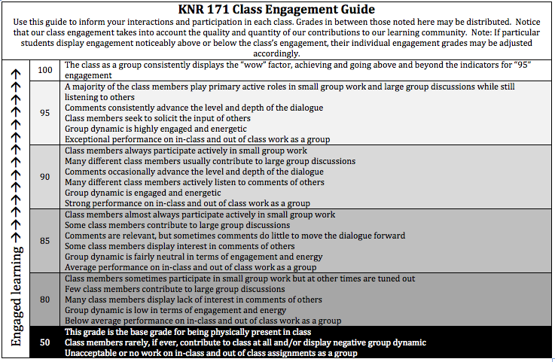
Individual engagement => Class engagement
Notes:
Tracy

Slide 11
How I Approached the Supersize
First Step: One day of panic
Second Step: Meet with CTLT for Individual Consultation to organize my thoughts and establish priorities
Third Step: Make intentional adjustments
Individual engagement => Class engagement
Streamlining learning: Elimination of midterm, project piece, course topics (Opening up space)
Increased use of self assessment and reflection on individual leadership development
Enhanced use of established student mentors
Notes:
Tracy

Slide 12
How I Approached the Supersize
First Step: One day of panic
Second Step: Meet with CTLT for Individual Consultation to organize my thoughts and establish priorities
Third Step: Make intentional adjustments
Individual engagement => Class engagement
Streamlining learning: Elimination of midterm, project piece, course topics
Increased use of self assessment and reflection on individual leadership development
Enhanced use of established student mentors
Notes:
Tracy

Slide 13
How I Approached the Supersize
First Step: One day of panic
Second Step: Meet with CTLT for Individual Consultation to organize my thoughts and establish priorities
Third Step: Make intentional adjustments
Individual engagement => Class engagement
Streamlining learning: Elimination of midterm, project piece, course topics
Increased use of self assessment and reflection on individual leadership development
Enhanced use of established student mentors
Notes:
Tracy

Slide 14
Enhanced use of student mentors
Student mentors helped facilitate previous semesters’ large group discussions as smaller group discussions
Each student mentor assigned to specific group of students as ‘go to’
Student mentors trained how to ‘wander’ during small group activities
Student mentors oversaw and assisted with assessment of group facilitation experiences – rubrics adjusted
Notes:
Tracy

Slide 15
What I Learned
Still believe that this course is best suited for class sizes of 20-30 students
Mid-semester and end-of-semester student evaluation comments and rating were consistent with previous semesters
Only noticeable change to workload was grading load
Should embrace every opportunity to stream line and focus course learning
Notes:
Tracy

