Slide 1
Triggers And Safe Zones: Creating Constructive Class Discussion On Sensitive Issues
CTLT Teaching Symposium
School of Communication
Diversity and Inclusion Committee
Jan. 2017

Slide 2
Open Discussion
Sensitivity to Student Needs
Barriers!

Slide 3
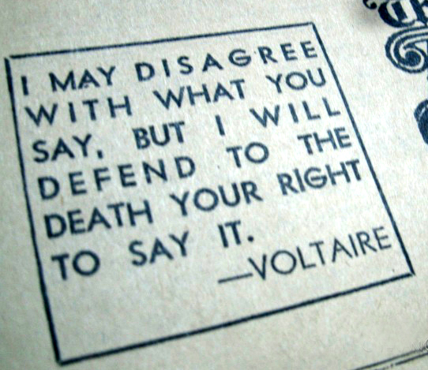
Preview
Safe Spaces & Trigger warnings
Echo Chambers
Spirals of Silence
What are their strengths and limitations?
When are they appropriate or not?
Our key question: How can we build spaces of dialogue with (or without) safe zones or triggers?

Slide 4
“Safe spaces, while beneficial in ways, take away your freedom. When someone says something you find offensive or do not agree with, do not run away. Do not hide. Engage in conversation. Embrace your first amendment right. How else can we move forward as humans if we are not willing to discuss opposition?”

Slide 5
“Understood as the avoidance of stress, ‘the safe space’ metaphor drains from classroom life every impulse toward critical reflection.”
Robert Boostrom, 1998, p 406
“The metaphor of the classroom as a ‘safe space’ has emerged as a description of a classroom climate that allows student to feel secure enough to take risks, honestly express their views, and share and explore their knowledge, attitudes and behaviors. … protection from psychological or emotional harm.”
Lynn Holley and Sue Steiner, 2005, p 50
Two suggestions to re-conceive the metaphor:
“Classroom civility… a movement away from concern with psychological constructs (invisible) to behavioral constructs (visible).”
“safe space as relational work… how the people who cultivate safe spaces recognize and negotiate sometimes deeply problematic differences.”
Betty Barrett, 2010, p 10
Roestone Collective, 2014, p1347-8

Slide 6
In reviewing academic literature:
power
protection
Differential power:
instructor and student
marginalization
Free speech
academic freedom
paternalism (negative)
perspective
identities
ideological
experiences
Characteristics that support ‘safe spaces’:
Instructors whom students perceive as nonjudgemental or unbiased
Ground rules for discussion + active participation from multiple perspectives
Individuals who feel comfortable with conflict / raising controversial issues
Lynn Holley and Sue Steiner, 2005

Slide 7
Spirals Of Silence in the Classroom

Slide 8
Spiral of Silence theory (Noelle-Neumann)
Central Assumptions:
Perceptions about public opinion influence expression
Pressure to conceal minority views due to fear of isolation
Research on Spiral of Silence in the Classroom
“Students may silence expression of views they may see as divisive or that may cause conflict with teachers in order to ‘fit in’ and work with the teacher” (Eckstein & Turman, 2002, 188).
Teachers can lessen this effect by being more cognizant of any silencing behaviors (e.g., naming, not naming, and smoothing over) they may engage in during in class discussions.

Slide 9
discussion

Slide 10
discussion
How do you try to create an engaging and “safe” environment for everyone to speak?
How do introduce controversial issues for discussion in your classes?
How do you manage controversial issues in your class if/when they emerge?

Slide 11
discussion
What do you think of when you hear the words “safe space” or “safe zone”?
If you feel positively about the terms, how do you think they should be implemented?
If you feel negatively about the terms, what alternatives do you suggest?

Slide 12
discussion
If certain student populations (potentially) feel uncomfortable or if you think they may hold a minority view on the topic being discussed, how do you try to encourage them to speak – or how do you try to create an atmosphere where they feel comfortable sharing their views?

Slide 13
discussion
Do any of you have incidents that you would like to share with us when you were challenged with maintaining civil discourse concerning a controversial issue, and how you ultimately dealt with the situation?

