Slide 1
Student-Centered Learning in Sustainable Label Development
Yoon Jin Ma, Ph.D. & Hae Jin Gam, Ph.D.
Department of Family and Consumer Sciences
College of Applied Science and Technology

Slide 2
Sustainability in Apparel Products
The apparel industry is arguably one of the most detrimental to the environment.
Consumer concerns about environmental problems from unsustainable practices have considerably increased.
To help resolve these problems from apparel production, efforts should be made by apparel producers, retailers, consumers, as well as educators.

Slide 3
Sustainability in the Curriculum
Sustainability-related courses are limited in the current FCS curriculum.
Need to help students be more knowledgeable and environmentally conscious as a consumer as well as a future professional in the apparel industry.
We developed a research team with students to create an informative and consumer-friendly label with easy to ready symbol.

Slide 4
Procedure
Student researcher recruiting:
1 graduate student, 7 undergraduate students,
2 faculty supervisors
Brainstorming:
idea generation, literature review, market research
Weekly-meeting:
discussion of the team-based assignments

Slide 5
Creating an informative and consumer-friendly label for apparel products with easy-to-read symbol
Design:
Creating label layouts and symbols
Evaluating materials
Marketing:
Developing and expanding partner collaborations
Research:
Conducting focus group discussion and analysis

Slide 6
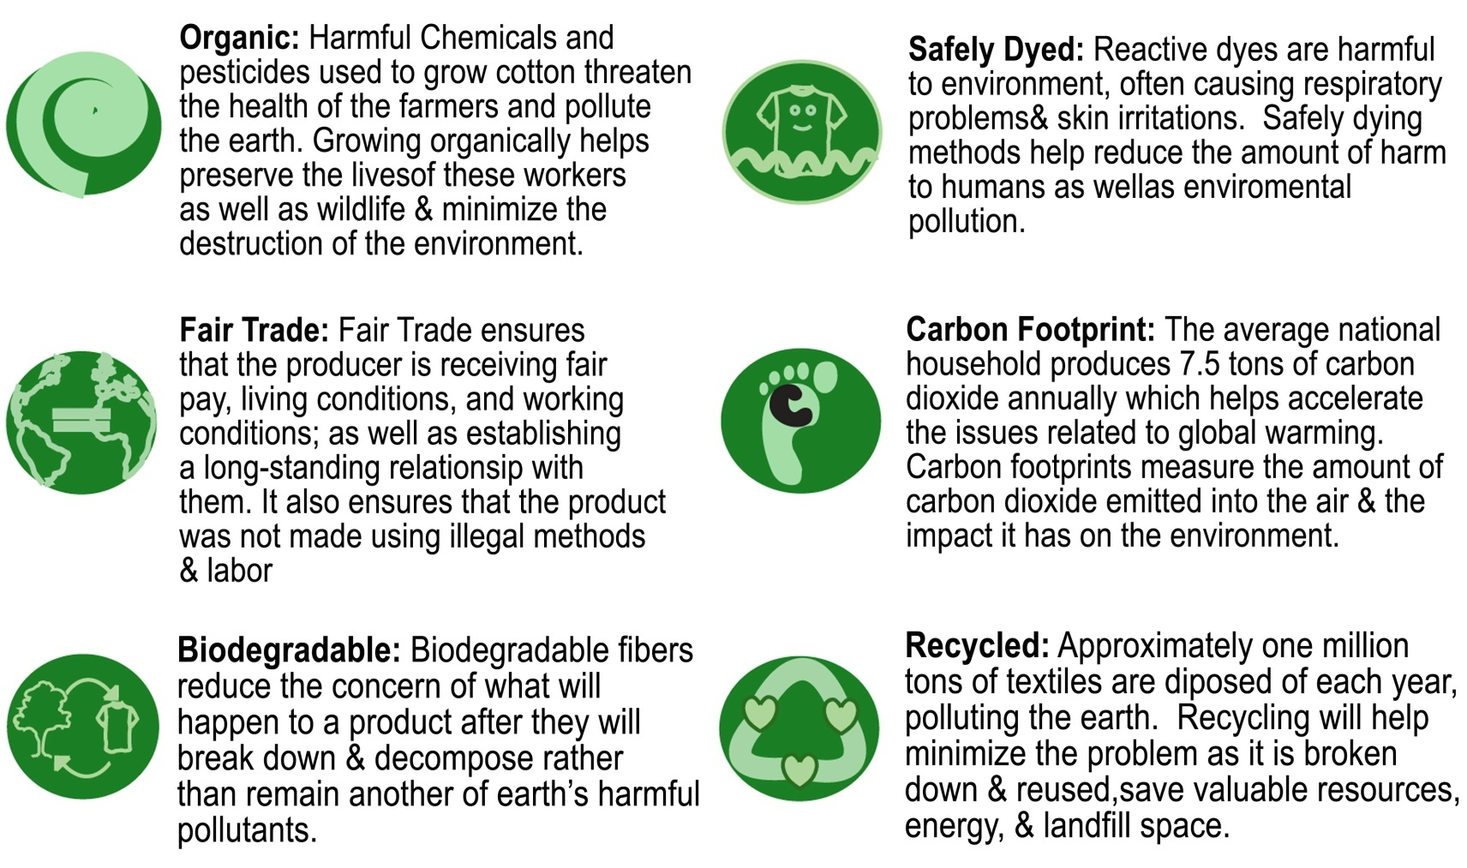
Student Outcomes: In(green)dients label Design
Identifying six sustainable aspects & symbol designs

Slide 7
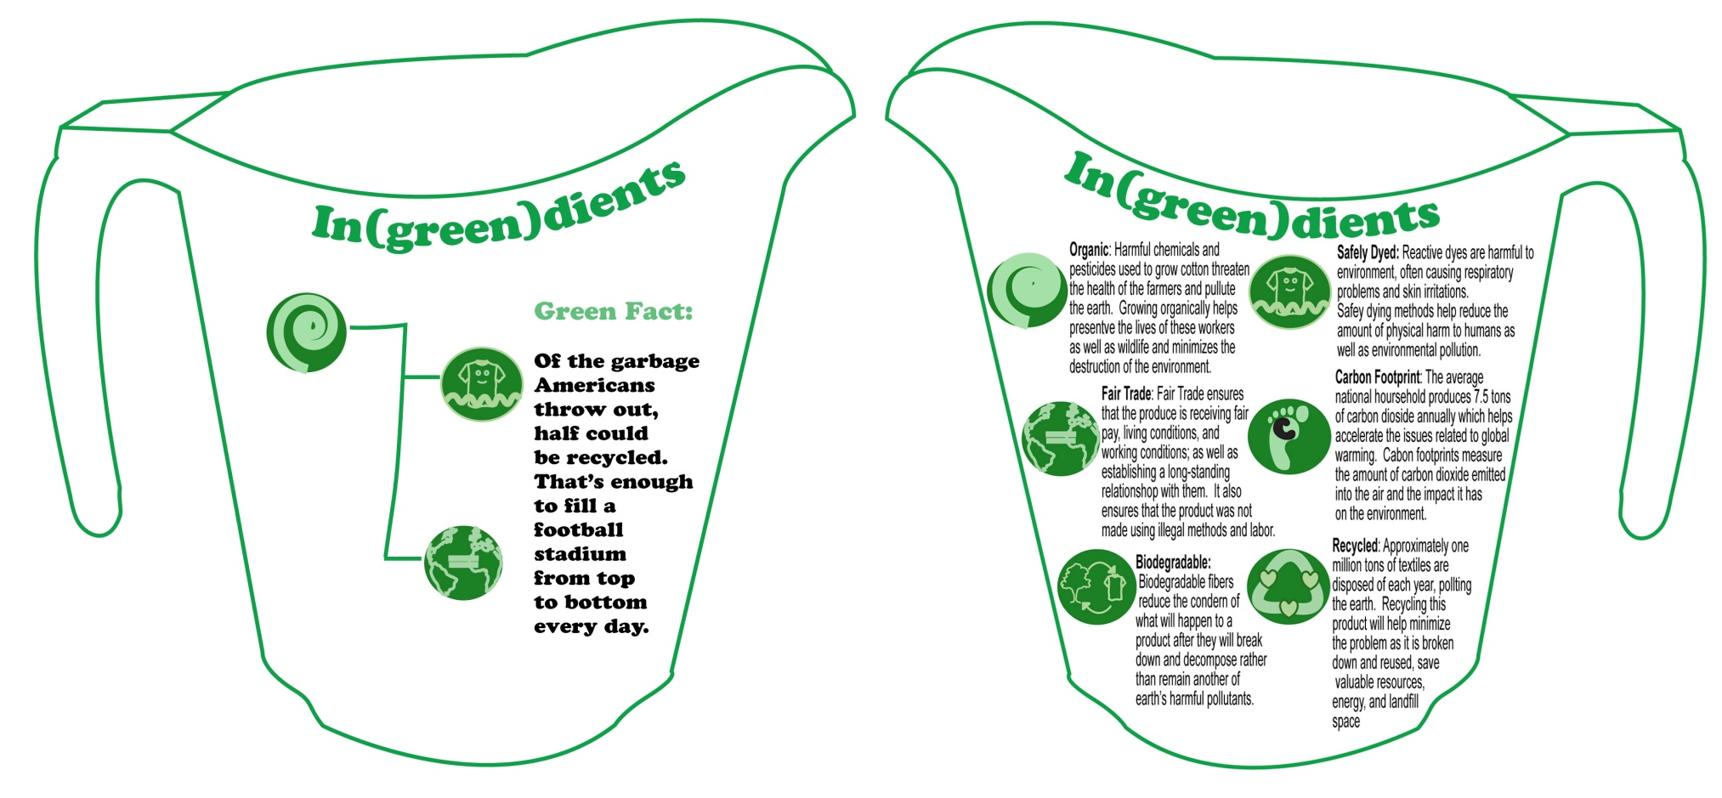
Student Outcomes: Design
Label layout design development

Slide 8
Student Outcomes: Design
Material evaluation:
With two choices, a recycled paper, or a flower seed paper (contains seeds in the paper).
Rather than just throwing away a clothing hangtag, our label can be planted.

Slide 9
Student Outcomes: Research
Focus groups: to examine consumers’ knowledge of sustainability issues, input on current green clothing labels, and opinions on the label prototype
Generating discussion questions
IRB approval
Recruiting participants
Conducting three focus groups
Transcribing the discussions
Analyzing the results

Slide 10
Student Outcomes: Marketing
Collaboration:
Visiting local retail stores to find out potential partnerships
Developing materials for meeting (official letters, label designs, agreement contract form, etc.)
Making appointment for a meeting
Presenting the project to managerial level.
Oops and Crossroads-Global Handcrafts

Slide 11
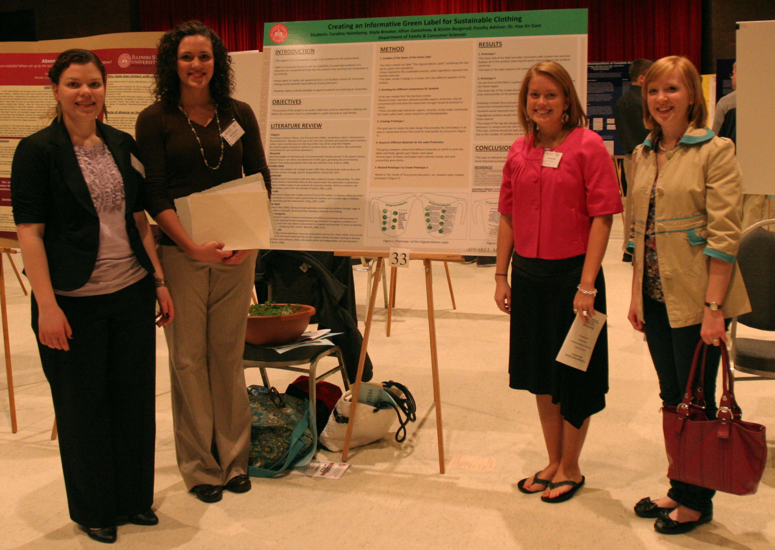
Student Outcomes: Design

Slide 12
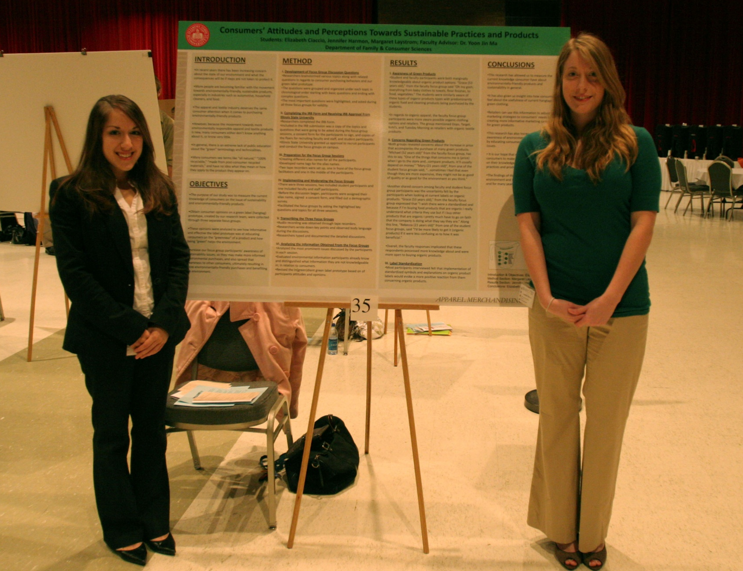
Student Outcomes: Research

Slide 13
Students Feedback
Developing career skills:
…not many Undergraduates get an opportunity to be involved in a research project of this magnitude. I feel that by being involved in this project gives me more of a competitive edge because it makes me stand out from other students in my field.
I think that experience of starting a detailed project like this from start to finish will be very beneficial when trying to stand out in the job market.
The project is based around the concept of economically friendly textiles which is an upcoming market trend, which gives me a competitive edge because it shows I’m aware of market trends.

Slide 14
Students Feedback
Developing career skills:
I was responsible in keeping deadlines, which is an important skill in the professional world.
This project, as well as a previous green design project, has changed my view on how clothing design can and should be changed for the future.
The whole concept of sustainable design for clothing and how to communicate the benefits to the consumer is new and innovative, so to have experience dealing with these issues has changed my mindset and provided me with knowledge that I think will definitely provide me with an advantage in the job market.

Slide 15
Students Feedback
Specific skills learned from the project: Collaboration
I think that I have acquired how to work in a group, working with others on a project, and learning to take criticism on something that I created.
I developed teamwork skills, initiative skills, and people skills from calling and talking to businesses.
It has opened my eyes more to the views of others. After listening to the focus groups, I heard a lot of comments I wouldn’t have thought of. I will try to keep the ideas of other in mind in the future when thinking critically.

Slide 16
Students Feedback
Specific skills learned from the project: Problem solving, Decision making
My ability to be an effective problem solver was benefited by doing this project because there were new problems and ideas that arose each time we met every week. There were always new issues and ideas that were associated with the prototype label. Every week the researchers made adjustments to the prototype in order to make it ideal to the consumer.
I can think about the problems longer and deeper…. I feel like I can make better decisions now because of being able to critically think about the different problems and solutions.

Slide 17
Students Feedback
Specific skills learned from the project: Research skills
I wasn’t one of the designated ‘researchers’ in the group, but I do feel my researching skills have improved nonetheless.
My confidence in this area has increased as a result of this project. I learned how to distinguish reliable and valid sources from the rest. I was able to communicate any research problems I had to faculty supervisors and learned where to look for relevant information.
I do feel more comfortable because I had never had experience in doing any research study before. Now, I have an idea of the proper steps to take in order to make the decisions and be able to participate fully. I have learned how to look at a topic and be able to research it better and feel like my research has been effective.

Slide 18
Conclusion
Overall very positive students’ feedback
Good research experience with students
Findings will be disseminated through international, national, and regional conferences.

