Slide 1
Adventures in Civic Engagement
Maria Schmeeckle, Dept. of Sociology and Anthropology
Katie Foley, Senior Sociology Student, ISU
Presentation for CTLT Annual Symposium on Teaching and Learning, Jan. 9, 2013

Slide 2
Civic Engagement components
Voice and Action course goal (see handout)
3 main course activities:
Student blogs (public blogs using Wordpress)
Service learning (3 options)
Field trip to Chicago for Albany Park Theater Project’s
production of Home/Land

Slide 3
Student Blogs
www.childreninglobalperspective.wordpress.com

Slide 4
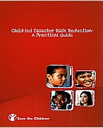
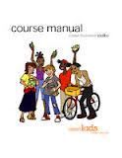
Service learning
Option 1: Search, assess, and organize Best Practice documents related to children

Slide 5
Service learning
Option 2: Children’s Discovery Museum: creating an interactive, educational experience for local children, raising their awareness about children around the world

Slide 6
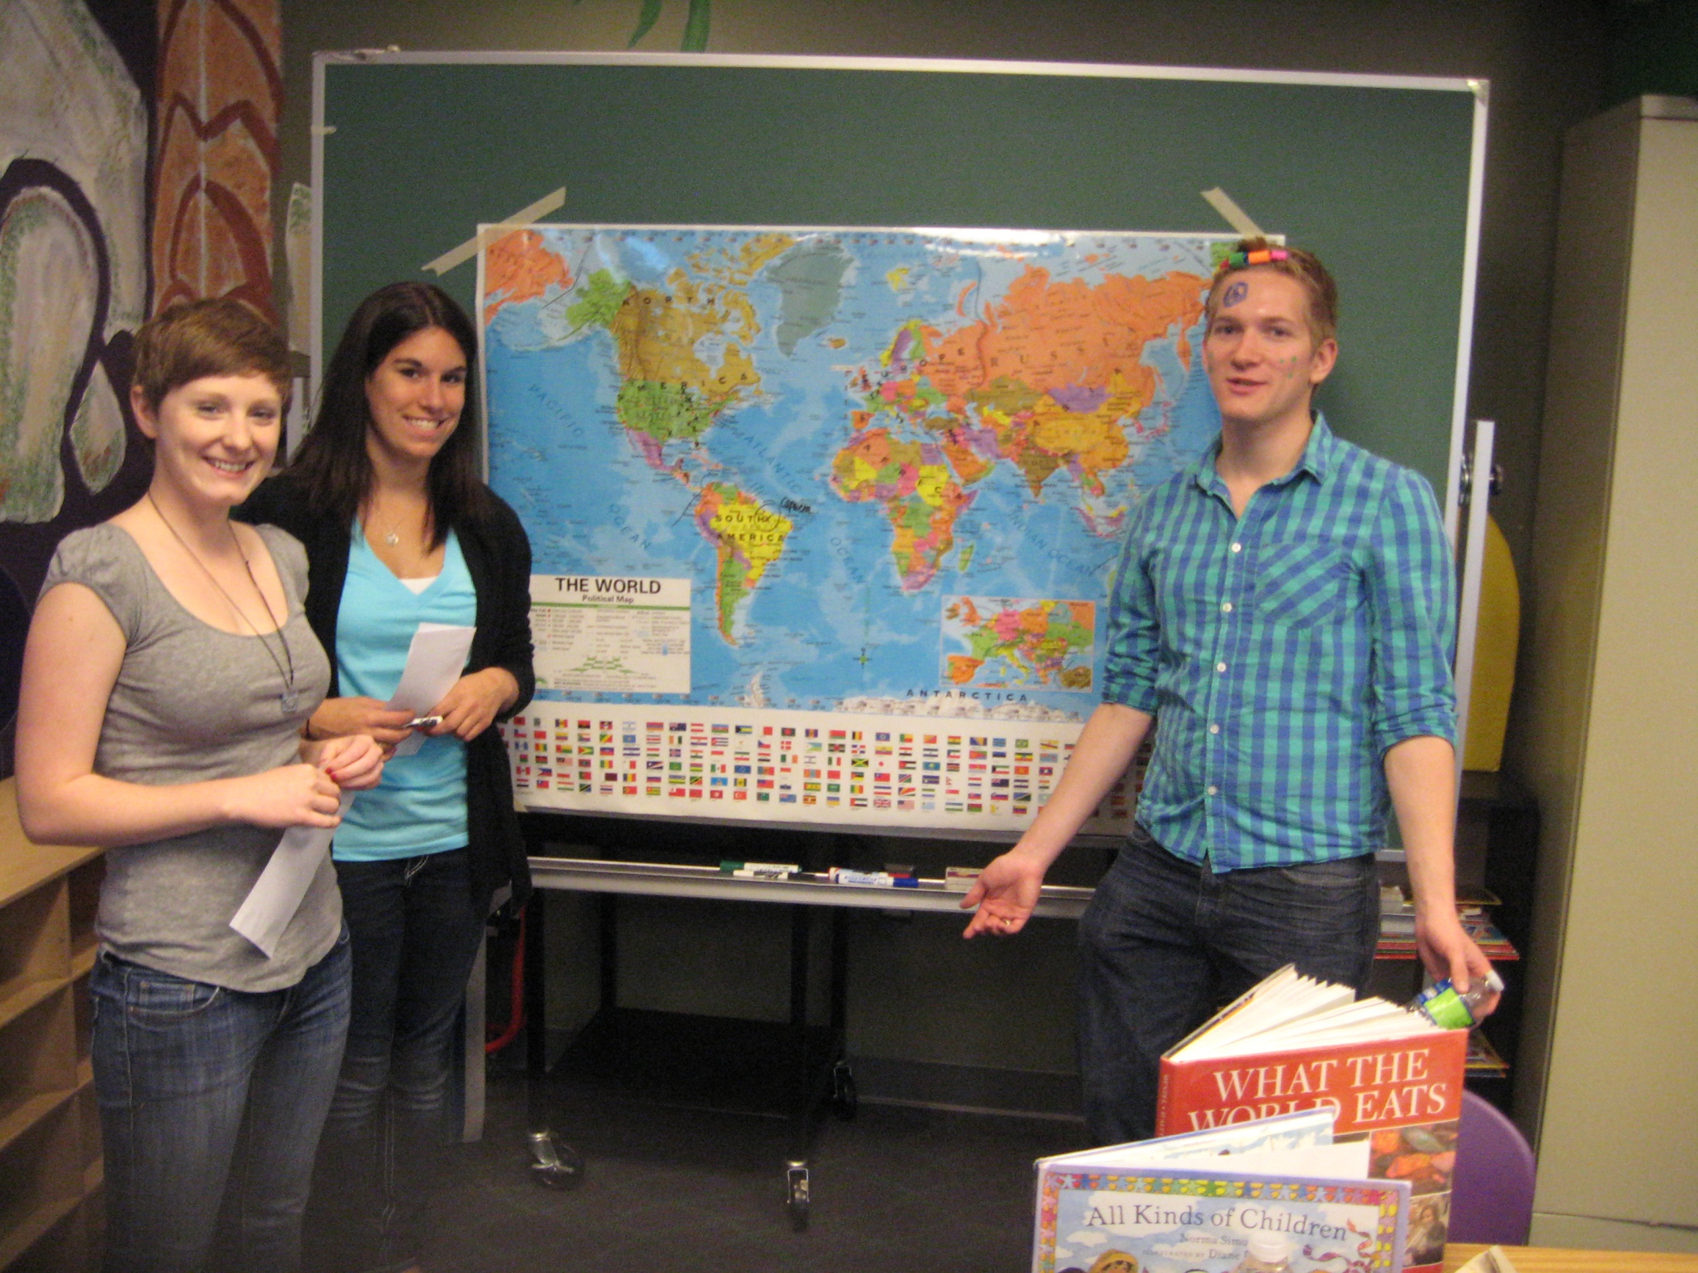

Slide 7
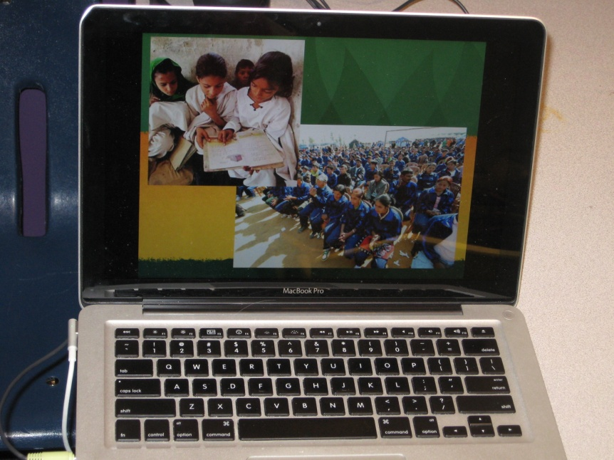
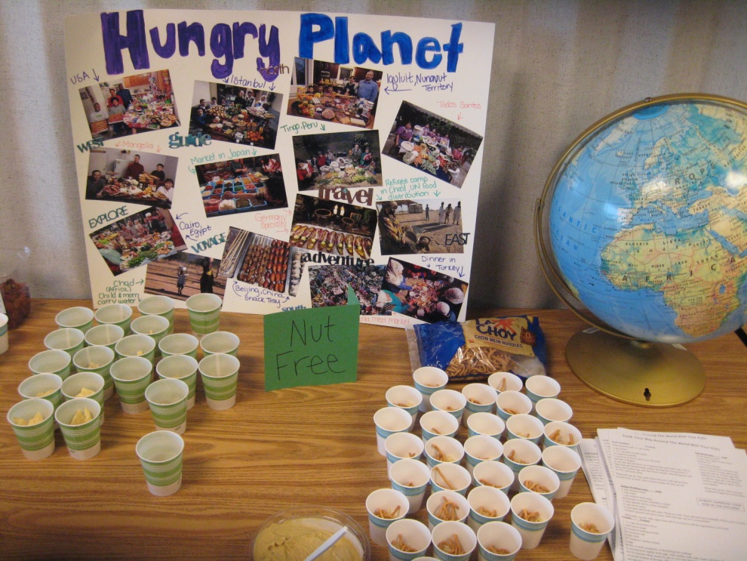
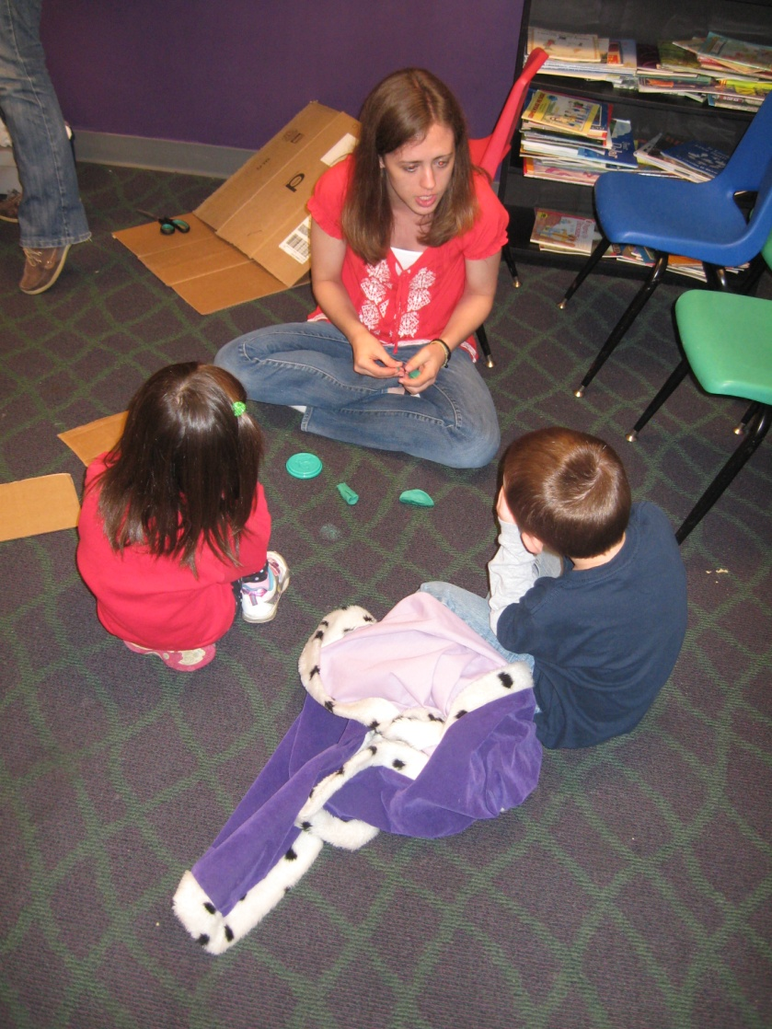
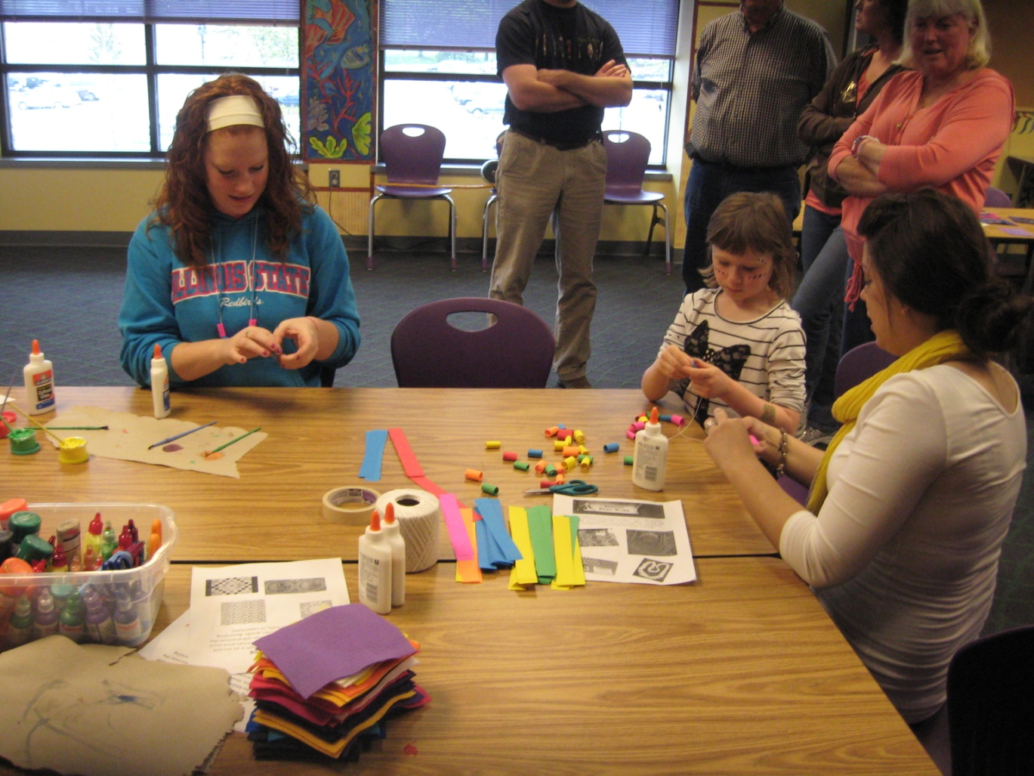

Slide 8
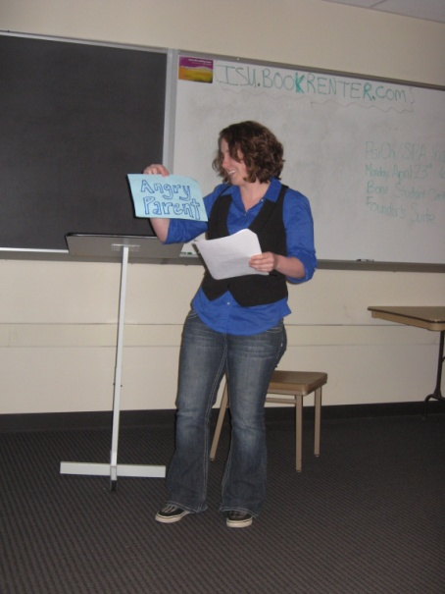
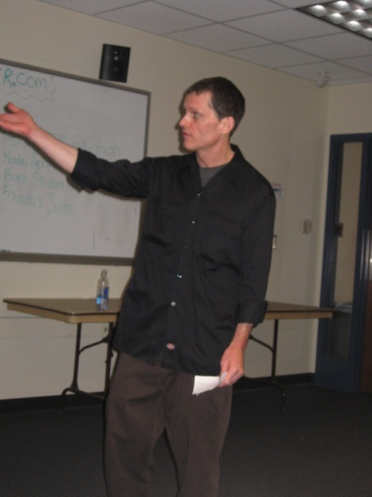
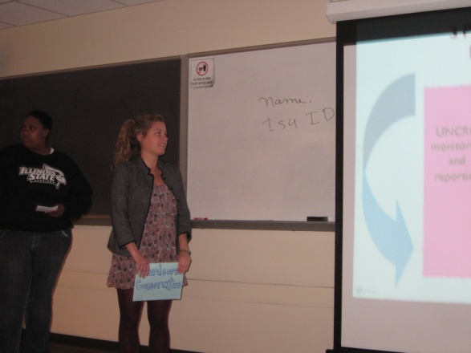
Service learning
Option 3: Learn about and Present Publicly about the United Nations Convention on the Rights of the Child
Prezi presentation is available on-line: http://prezi.com/crfd_sixxkoc/ratification-of-convention-on-the-rights-of-the-child/

Slide 9
Field trip
Albany Park Theater Project in Chicago, production of Home/Land
http://aptpchicago.org/
10 minute DVD of field trip and student reflections

Slide 10
Comments from Katie Foley
Guiding Questions
How common has it been to have a civic engagement approach in your classes?
As you look back on the class, what would you say was the most impactful thing we did?
In what way did your public voice or ability to take action become enhanced in the course?

Slide 11
Future ideas
Google Earth projects, showing issues related to children in a geo-spacial way
American Sociological Association Wikipedia Initiative: update and create more content in wikipedia about children and youth
Teach local middle and high school students about children from a global perspective

