Slide 1
Cultural Identity in Design :: reason : reflect : respect
Archana Shekara, Illinois State University

Slide 7
project 1 : cultural identity # object

Slide 8
Victor Stuber Switzerland

Slide 9
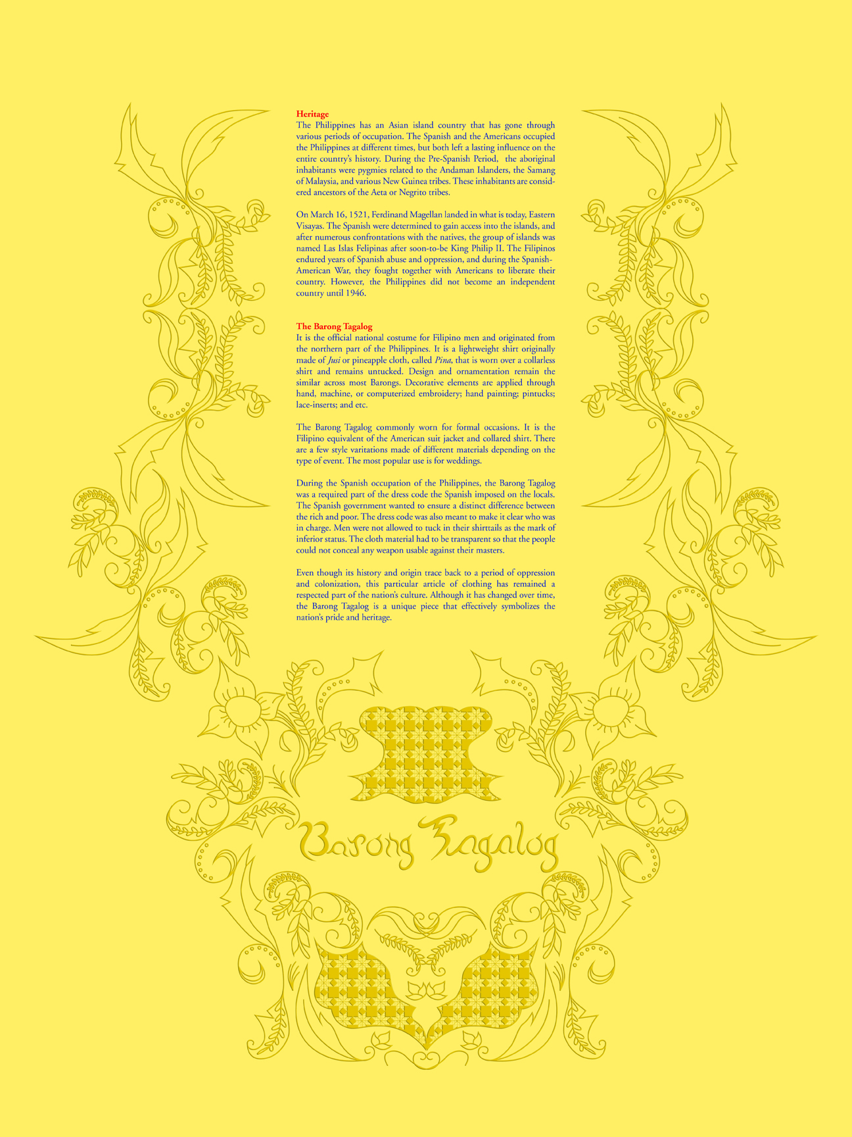
Melanie Lecaroz Philippines

Slide 10
Jessica Hannel Germany

Slide 11
White Privilege: Unpacking the Invisible Knapsack :: Peggy McIntosh
DAILY EFFECTS OF WHITE PRIVILEGE
I decided to try to work on myself at least by identifying some of the daily effects of white privilege in my life. I have chosen those conditions that I think in my case attach somewhat more to skin-color privilege than to class, religion, ethnic status, or geographic location, though of course all these other factors are intricately intertwined. As far as I can tell, my African American coworkers, friends, and acquaintances with whom I come into daily or frequent contact in this particular time, place and time of work cannot count on most of these conditions.
I can if I wish arrange to be in the company of people of my race most of the time.
2. I can avoid spending time with people whom I was trained to mistrust and who have learned to mistrust my kind or me.
3. If I should need to move, I can be pretty sure of renting or purchasing housing in an area which I can afford and in which I would want to live.
4. I can be pretty sure that my neighbors in such a location will be neutral or pleasant to me.
5. I can go shopping alone most of the time, pretty well assured that I will not be followed or harassed.
6. I can turn on the television or open to the front page of the paper and see people of my race widely represented.
7. When I am told about our national heritage or about “civilization,” I am shown that people of my color made it what it is.
8. I can be sure that my children will be given curricular materials that testify to the existence of their race.
9. If I want to, I can be pretty sure of finding a publisher for this piece on white privilege.
10. I can be pretty sure of having my voice heard in a group in which I am the only member of my race.
11. I can be casual about whether or not to listen to another person’s voice in a group in which s/he is the only member of his/her race.
12. I can go into a music shop and count on finding the music of my race represented, into a supermarket and find the staple foods which fit with my cultural traditions, into a hairdresser’s shop and find someone who can cut my hair.
13. Whether I use checks, credit cards or cash, I can count on my skin color not to work against the appearance of financial reliability.
14. I can arrange to protect my children most of the time from people who might not like them.
15. I do not have to educate my children to be aware of systemic racism for their own daily physical protection.
16. I can be pretty sure that my children’s teachers and employers will tolerate them if they fit school and workplace norms; my chief worries about them do not
concern others’ attitudes toward their race.
17. I can talk with my mouth full and not have people put this down to my color.
18. I can swear, or dress in second hand clothes, or not letters, without having people attribute these choices to the bad morals, the poverty or the illiteracy of
my race.
19. I can answer and speak in public to a powerful male group without putting my race on trial.
20. I can do well in a challenging situation without being called a credit to my race.
21. I am never asked to speak for all the people of my racial group.
22. I can remain oblivious of the language and customs of persons of color who constitute the world’s majority without feeling in my culture any penalty for such oblivion.
23. I can criticize our government and talk about how much I fear its policies and behavior without being seen as a cultural outsider.
24. I can be pretty sure that if I ask to talk to the “person in charge”, I will be facing a person of my race.
Peggy McIntosh is associate director of the Wellesley Collage Center for Research on Women.

Slide 12
project 2 : cultural identity # citizen designer

Slide 13
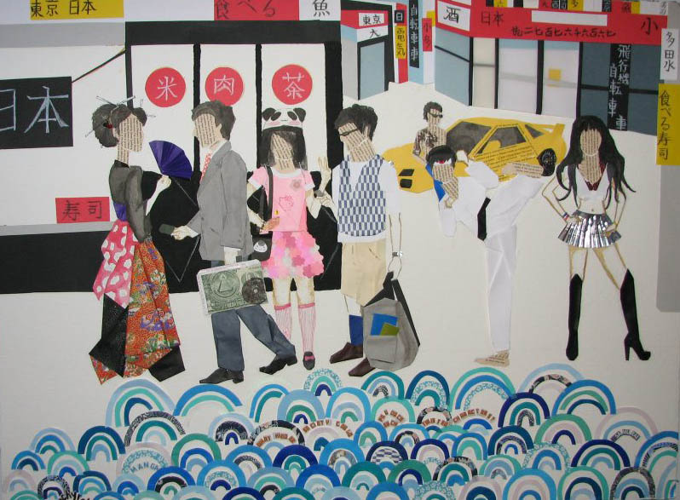
Akiko Slaughter Japan

Slide 14
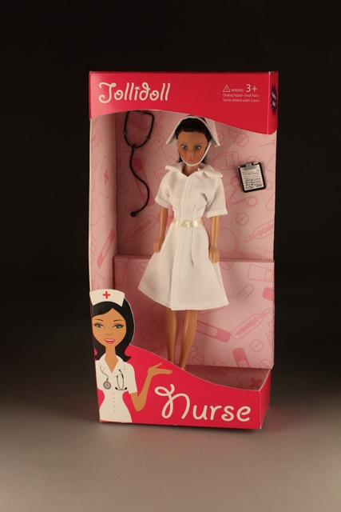
Melanie Lecaroz Philippines

Slide 15
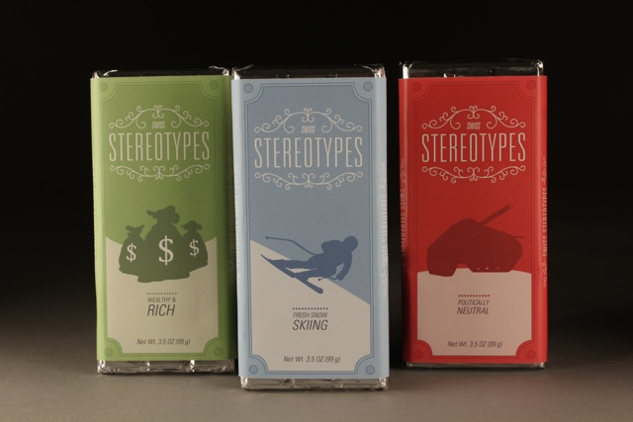
Victor Stuber Switzerland

Slide 16
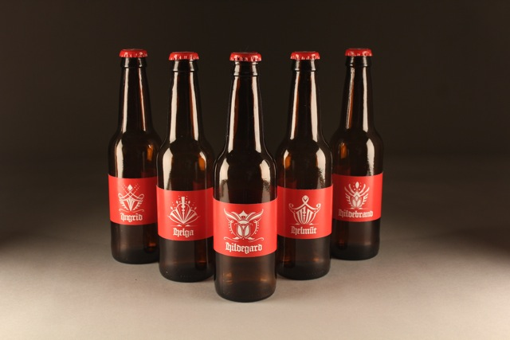
Jessica Hannel Germany

Slide 17
Melissa Curtin Turkey

Slide 18
Thank you
Archana Shekara
Assistant Professor of Graphic Design
School of Art
ashekar@ilstu.edu

