Slide 1
Teaching & Learning Across Contexts: Engaging Students In and Beyond the Classroom Bridget Reeland Dave Jaeger Illinois State University

Slide 2
Session Outcomes
Attendees will:
Understand benefits of living learning environments as suggested by research
Gain knowledge of ISU history in regards to these environments
Share pride in student successes on living learning communities and consider future programs and partnerships

Slide 3
Session Overview
Share research on the benefits of living learning environments
Discuss history of ISU living learning communities, as well as other student affairs and academic affairs partnerships
Provide evidence of student successes within current living learning communities and previous community research

Slide 4
Benefits of living learning environments for partners
Academic
Residential Life
Enable smooth transition of learning from classroom to other environments
Expose students to their colleges sooner for a smooth transition into upper level coursework
Bridge academic and social elements of students experience
Increase student engagement inside and outside of the classroom
Achieve departmental mission
Benefit from academic expertise when crafting learning strategies
Identify and outreach to at-risk students
Engage students with faculty outside the classroom

Slide 5
Benefits for students
Living Learning Benefits
“Tinto (2002) reports the benefits of Learning Communities extended beyond a better understanding of course content. Learning community students develop their own supporting groups, and they spend more time together out of class, than do students in traditional classes- and do so in ways that students reported as supportive.”
(Journal of College and University Student Housing)
Enhanced Connections (with students, faculty, staff, university)
More willing to expend effort to succeed
More social, cultural, and extra curricular involvement
Participate in mentoring relationships

Slide 6
Benefits for students
“Students living in LLP’s report greater connection to the institution, a smoother transition to college during their first year, and greater academic and social involvement than do their non-participant peers
(Henry & Schein,1998; Inkelas &Weisman, 2003; McKelfresh, 1980)
“Students participating in LLP’s are more likely to interact with faculty than are non-LLP students regardless of how involved in the LLP they are
(Garrett & Zabriskie 2003)
“Students were more satisfied with the institution and persisted at a higher rate, showed significantly higher interactions with faculty
(St. Onge et al, 2003)

Slide 7
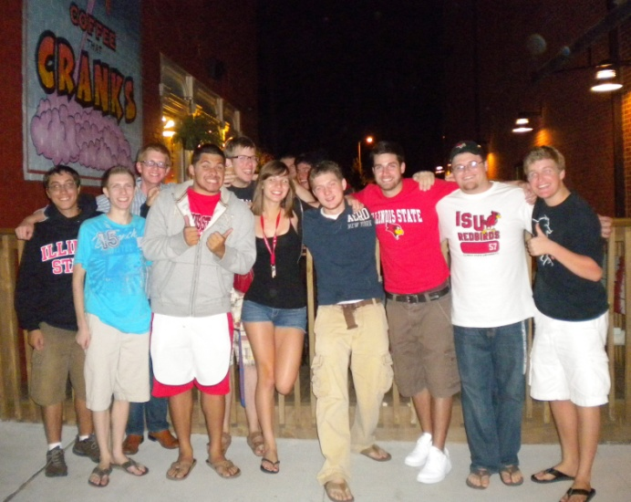
Introduction
Themed Living-Learning Communities provide a unique atmosphere for residents who share common interests and cultivate an environment that supports personal growth through academic and social programming

Slide 8
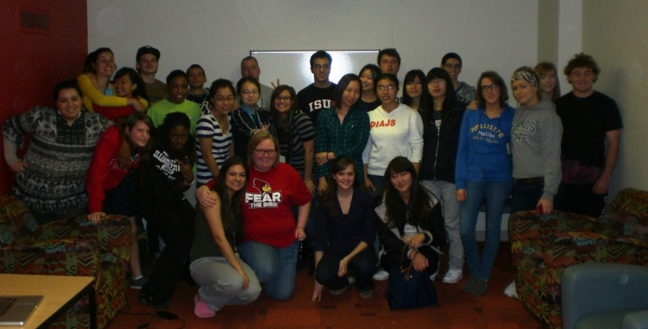
Introduction
Academic TLLCs
Special Interest TLLCs
Business
Co-Sciences
Communication Sciences and Disorders
Criminal Justice
Fine Arts
Honors
Information Technology
Math
Music
Nursing (Fall 14)
Presidential Scholars
ROTC
Teacher Education
University Scholars
International House
Leadership & Service
Sophomore Experience
Substance Free
Transfer
Wellness
ROTC and Veteran Student

Slide 9
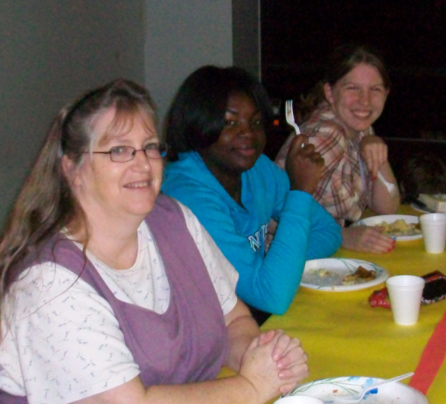
Program Partners
“One of the most persistent and least assailable assumptions in higher education has been than of the educational/developmental importance of informal student-faculty relationships beyond the classroom”
(Pascarell & Terenzini)
The Value of a Faculty Mentor
Resources for Floor Concerns/Issues
Social Interaction with Residents
Faculty Advice regarding Academics
Connection to Academic Departments
Resource for Career Tracks
Resources for Career Networking
Potential Reference for Students
Adult Perspective for Students
Academic Perspective for Students
Programming Partner for Developmentals/Socials
Advocate for Students Rights

Slide 11
NSLLP Overview
Conducted during the spring of 2010
Includes results/comparisons of 28 universities in the United States
Data compared to 374 Living-Learning Communities
Self-reported student statistics

Slide 12
Conceptual Framework and Study Method
Based off of Astin’s (1993) “Input-Environment-Outcome” Model
Research examines how the college environment influences student change or development
Sample compared two types of students:
Those participating in LLPs
Those not participating in LLPs

Slide 13
Major Constructs of NSLLP Survey Instrument
Inputs
Environments
Outcomes
Demographics
High School Achievement
Pre College assessment of college involvement and perceptions of self-confidence
Academic Major
Peer Interactions
Significant mentors, profession development, academy expectations, and confidence in STEM activities
Co-curricular involvement
Study group interactions
Alcohol-related experiences
Use of residence hall resources
Academic and social influences on LLP participation
Diverse interactions
Perceptions of campus racial climate
Time spent on leisure activities
Faculty interactions
Mentoring experience
Perceptions of residence hall climate
Perceptions of self-confidence
Appreciation of diversity
Perceptions of intellectual abilities and growth
Drop-out risk
Sense of civic engagement
Alcohol use and behaviors
Plans to return to institution
Self-reports of cumulative college grade point average
Overall satisfaction and sense of belonging
Estimations of academic and social transition to college

Slide 14
Process and Data Collection
Two parts:
baseline questionnaire
custom questions
Web based survey
Living-Learning sample size: 929 residents, Responses: 167 residents (17.98%)
Non Living-Learning sample size: 904 residents, Responses 95 residents (10.51%)
Overall NSLLP response rate (21.00%)

Slide 15
Findings
Illinois State University students participating in our Themed Living Learning Communities during spring 2010 reported*:
Higher course-related faculty interaction
Higher faculty mentorship
Higher use of co-curricular residence hall resources
Higher interactions with professors
Higher attendance at seminars and lectures
Higher cumulative college gpa
continued…

Slide 16
Findings (continued)
Illinois State University students participating in our Themed Living Learning Communities during spring 2010 reported*:
Higher agreement that the residence hall is academically and socially supportive
Higher positive peer diversity interactions
Higher intended participation in internship experiences
Higher ease with the social transition to college
Higher rates of overall sense of belonging
*These results were in comparison to a control group of Non-Themed Living Learning Community counterparts, are self-reported statistics, and were all found to be statistically significant by the Center for Student Studies

Slide 17
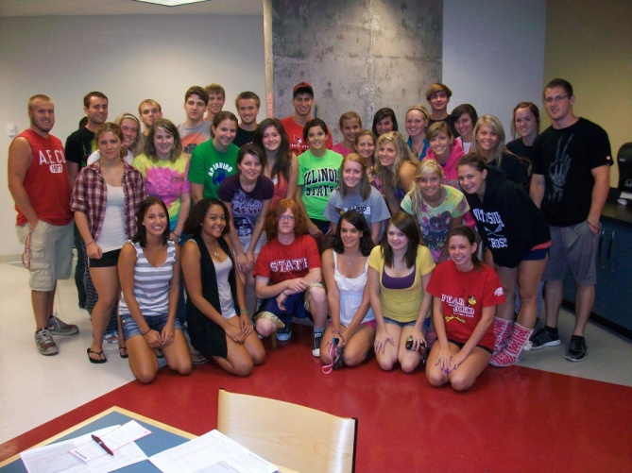
What residents have to say…
“I love living on the Leadership and Service floor. The experiences I have gained in this community helped me branch out into college and provided me with the ability to become a more developed leader in college”
“I greatly appreciate living in the Honors house because I live with other girls who are also academically motivated”
“I highly recommend living on a themed living floor. I have very easily made friends. I also highly take advantage of the academic resources available, such as the Visor Center and meeting with my professors”

Slide 18
Sources
Garrett, M.D.,& Zabriskie, M.S (2003). The influence of living-learning participation on student-faculty interaction. Journal of College and University Student Housing, 32 (2), 38-44.
Henry, K.B., & Schein, H.K. (1998). Academic community in residence halls: What differentiates a hall with a living/learning program? Journal of College and University Student Housing, 27 (20), 9-14.
Inkelas, K. K., & Weisman, J. L. (2003). Different by design: An examination of student outcomes among participants in three types of living-learning programs. Journal of College Student Development, 44 (3), 335-365.
McKelfresh, D. A. (1980). The effect of living learning environments on engineering students. Journal of College and University Student Housing, 10 (2), 16-18.
Pascarella, E.T., & Terenzini, P. (1991). How college affects students: Findings and insights from twenty years of research. San Fransisco: Jossey-Bass.
St. Onge, S. Peckskamp, T., & McIntosh, J. (2003). The impact of learning communities on residential communities and the roles of resident advisors. Journal of College and University Student Housing, 32 (I), 16-23.

Slide 19
Questions?

