Slide 1
Think Outside the Shell: Interdisciplinary Curriculum and Alligator Snapping Turtles January 8, 2014 Normal, IL Marriott Redbird F
Mike Soares
ISU Department of English

Slide 2
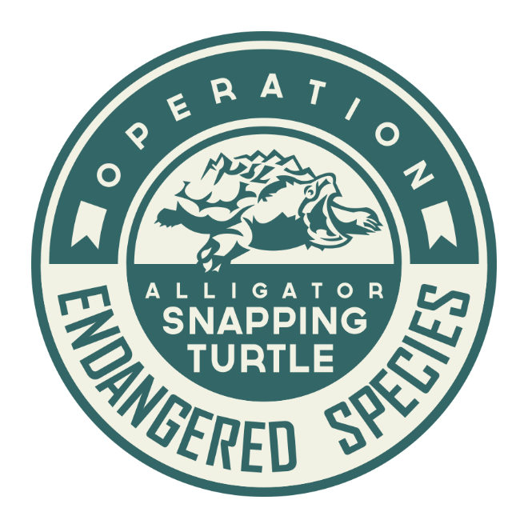
Operation Endangered Species

Slide 3
Introduction
Bachelors English Ed – 1991-1995
Masters in Literature – 2000-2004
PhD student in English Studies – 2013-present
English Instructor PTHS – 1997-present
NOT A BIOLOGY TEACHER ☺

Slide 4
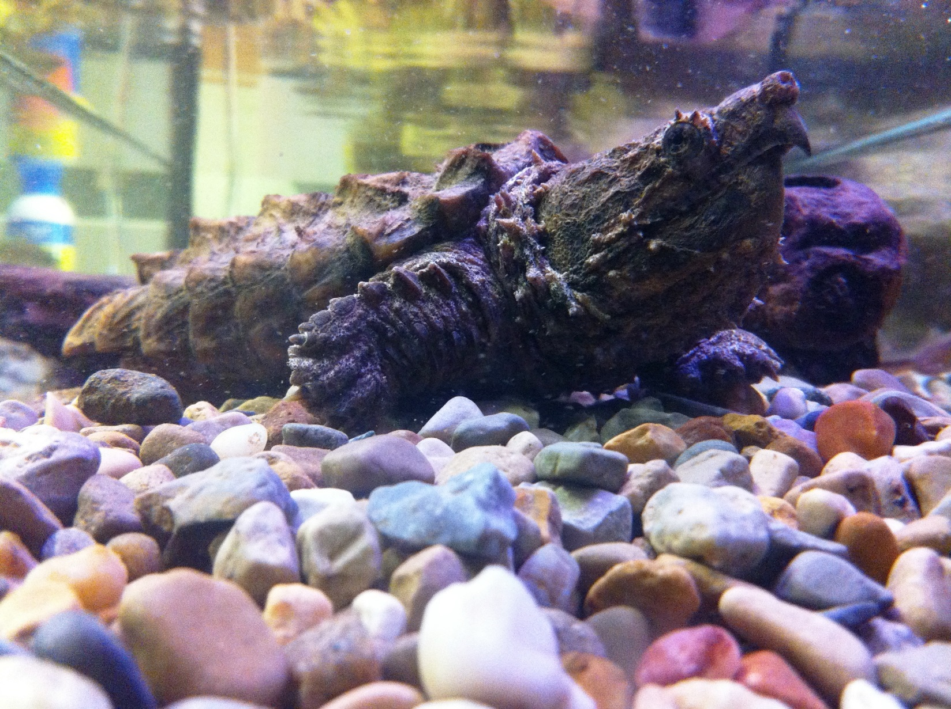
The Alligator Snapping Turtle

Slide 5
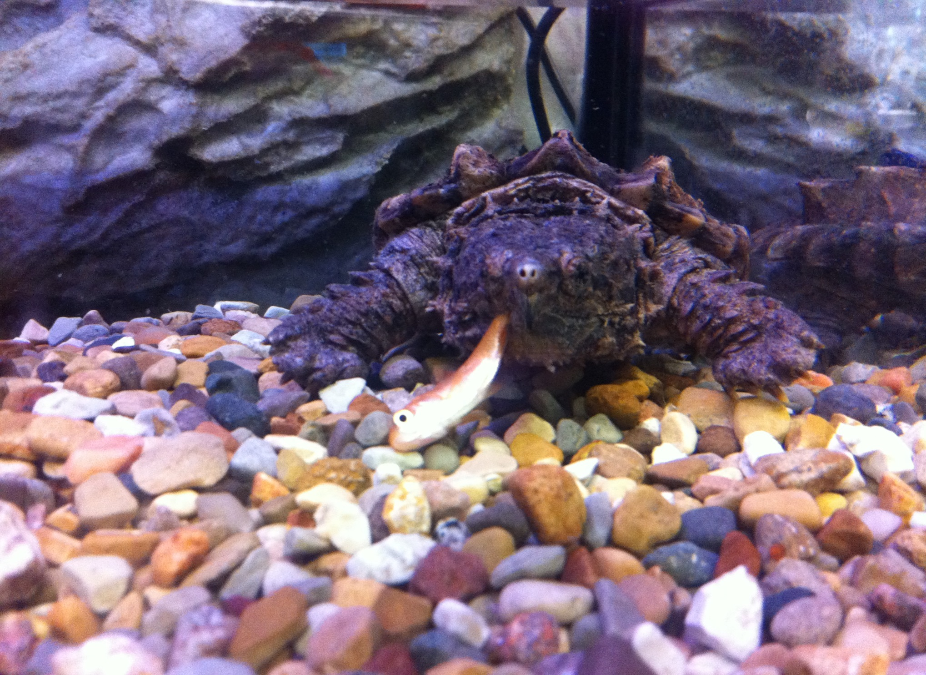

Slide 6
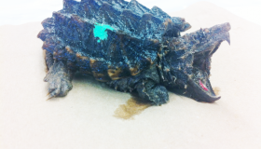

Slide 7
Turtle Facts
“Dinosaur of the turtle world”
Largest freshwater turtle in North America
Average lifespan 20-70 years
Males average 175 pounds
Can submerge for 40-50 minutes
Endangered in Illinois and protected by state law
“Adult snappers have no natural predators other than humans…”
Sources: National Geographic and Peoria Zoo

Slide 8
Program Philosophy
“What you get by achieving your goals is not as important as what you become by achieving your goals.”
Henry David Thoreau

Slide 9
The Mission
To engineer innovative education techniques through the use of pioneering interdisciplinary curriculum designed to empower students to write in a wide variety of new and familiar genres, to collaborate with a spectrum of students and professionals in multiple contexts, and to foster the eco-conscious objective of restoring an endangered species to a breeding population in its historical habitat.

Slide 10
The Rationale
Currently, local, state, and federal governments do not have the resources or funding to permanently save many of the organisms currently on the Endangered Species list. Furthermore, school districts across the United States have adopted the Common Core State Standards which require students to employ a wide variety of skills and knowledge with real-world applications. Operation Endangered Species seeks to address the recognized needs of all agencies and also the plight of organisms threatened with extinction through the empowerment of students in classrooms across the state to cooperate, collaborate, and create a template which reaches across many disciplines, easily adapts to any endangered species, and creates a curriculum template for giving students the tools to take action.

Slide 11
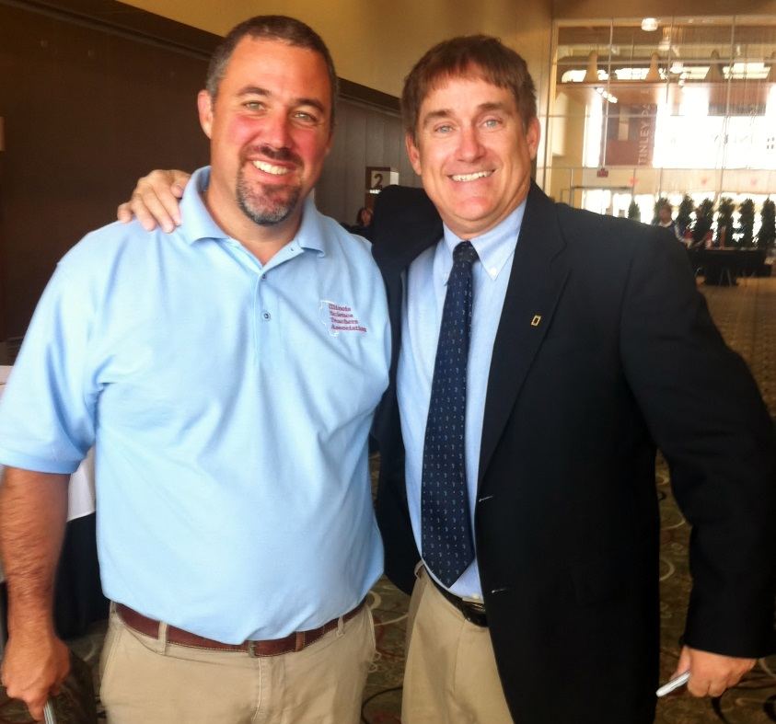
Genesis
Paul Ritter, President of the Illinois Science Teacher Association
Dr. Brady Barr, National Geographic
Illinois Department of Natural Resources
State Farm Youth Advisory Board

Slide 12
PTHS “Hub” School

Slide 13
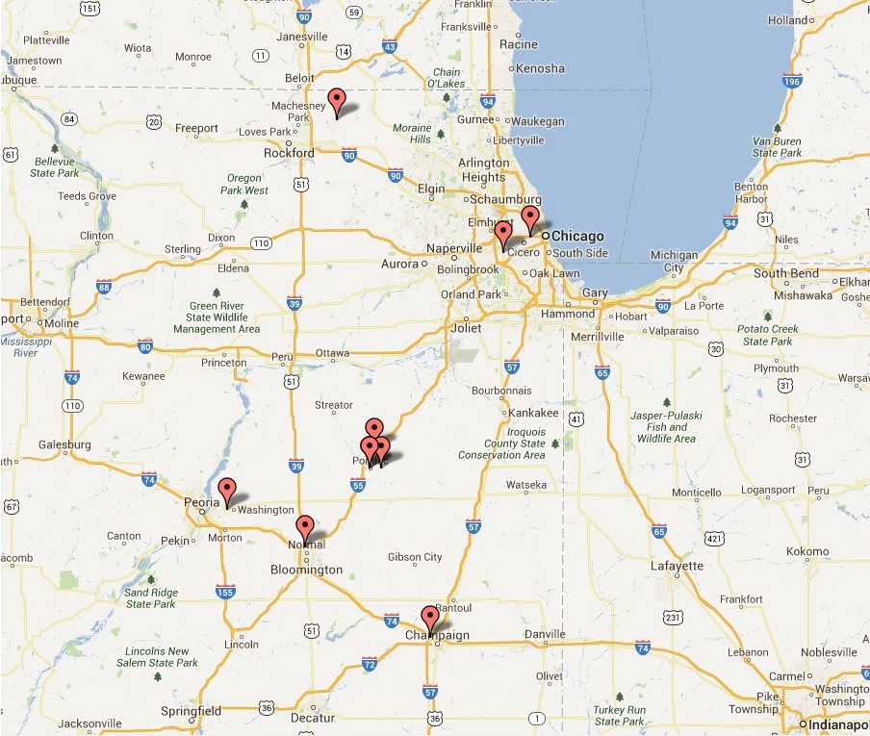
Map Operation Endangered Species Programs

Slide 14
Participating Schools
Elementary
Lincoln Elementary School, Pontiac
Metcalf Laboratory School, Normal
Washington Grade School, Washington
Middle School
Washington Middle School, Pontiac
High School
Pontiac TWP. High School, Pontiac
Booker T. Washington STEM Academy, Champaign
North Boone High School, Poplar Creek
Lyons TWP High School, La Grange
Whitney Young Magnet School, Chicago

Slide 15
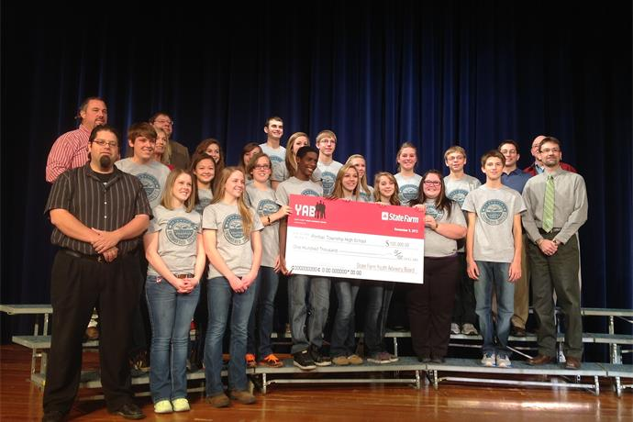
Funding
State Farm Youth Advisory Board - $100,000 grant
http://www.statefarmyab.com/projects/details/operation-endangered-species-the-alligator-snapping-turtle-project/
http://www.centralillinoisproud.com/story/pontiac-students-get-100k-to-save-endangered-allig/d/story/3dNTDVHgo0ehHR9ZJ_6Waw

Slide 16
$2,000 scholarship http://ing.us/about-ing/responsibility/childrens-education/unsung-heroes/award_winners?page=1 Nearly $2,500 in donated tanks and equipment through
Other Sources

Slide 17
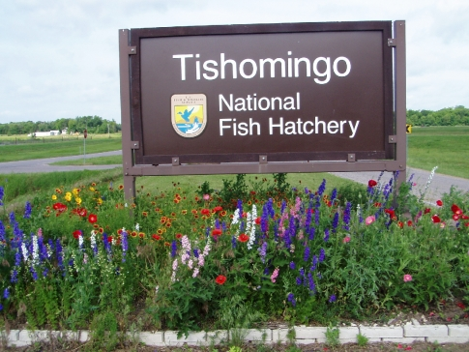
Support Organizations

Slide 18
Biology Classroom
Common Core Literacy Standards
Research, reading non-fiction text
“Write informative/explanatory texts, including
[…] scientific procedures/experiments…”
Next Generation Science Standards
Elementary – Interdependent Relationships in
Ecosystems
Middle School – Growth, Development, and
Reproduction of Organisms
High School – Matter and Energy in Organisms
and Ecosystems
“Real World Scientists”
→

Slide 19
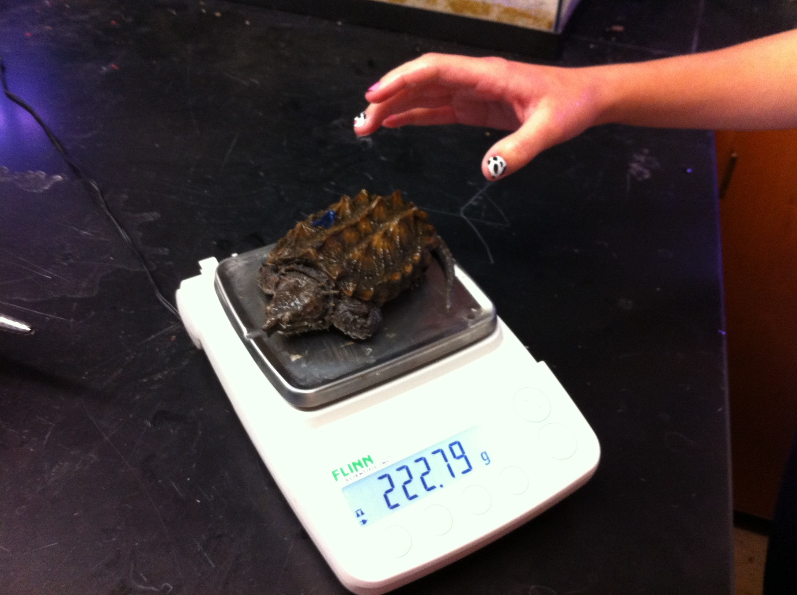
Equipment- Scale

Slide 20
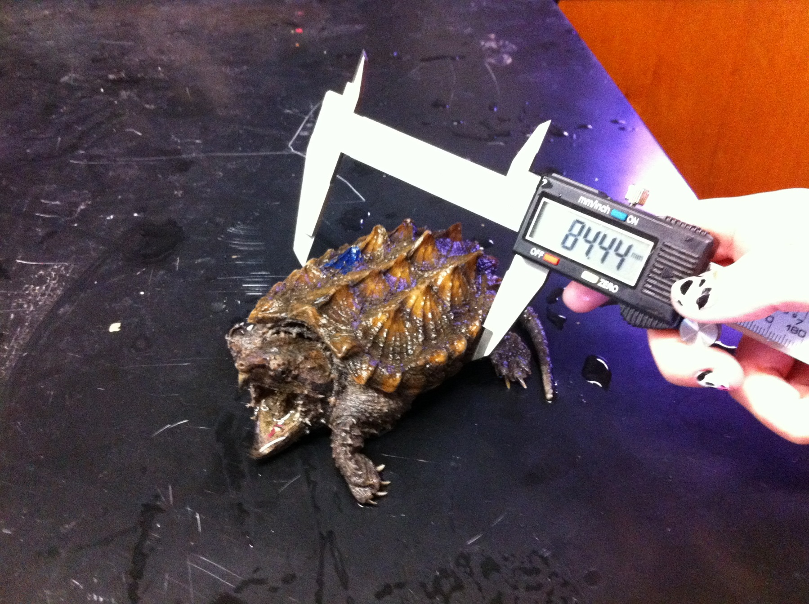
Equipment - Calipers

Slide 21
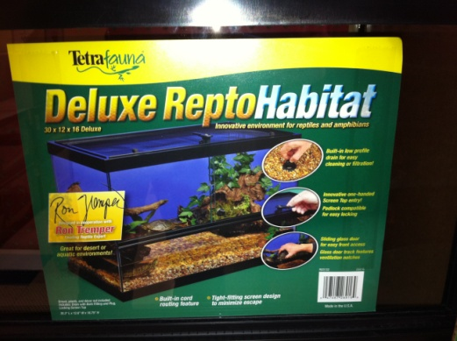
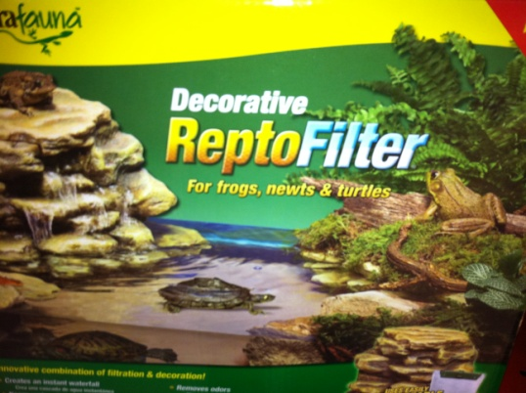
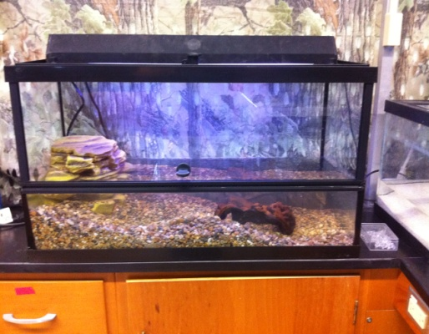
Equipment – Tank & Filter

Slide 22
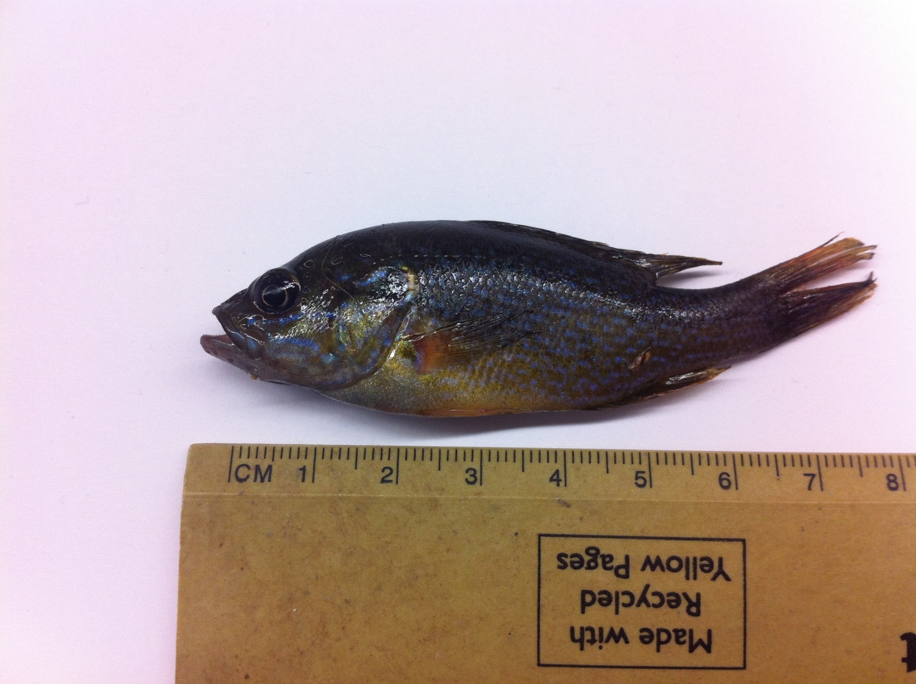
Food

Slide 23
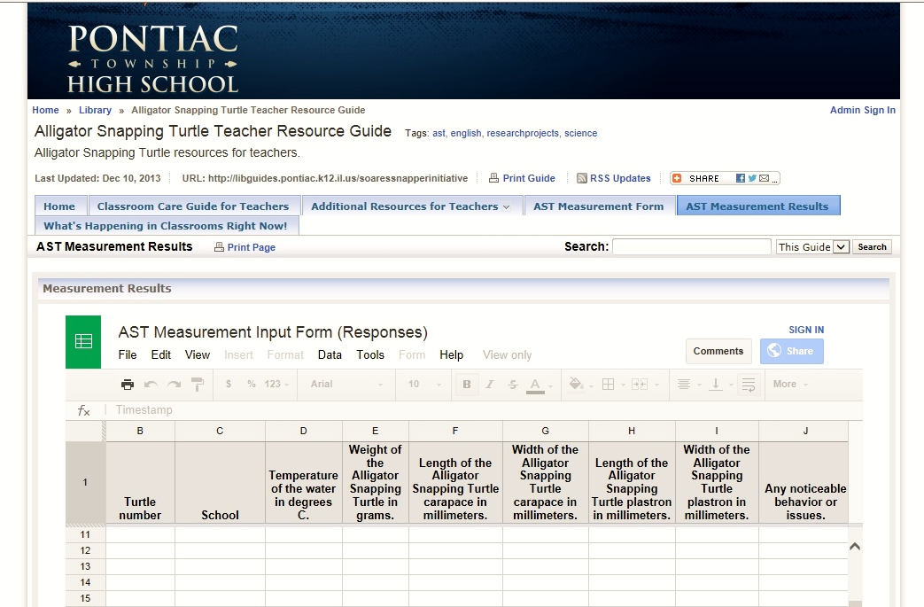
Measurements

Slide 24
English Classroom
Common Core Language Arts Standards
Reading: Informational Text - “technical meaning”
“analysis of ideas”
“different mediums”
Language - “Consult general and specialized
reference materials”
Writing – “precise language and domain-specific
vocabulary”
“Gather relevant information from
multiple authoritative print and digital
sources”
Writing in Multiple Genres

Slide 25
AST Multi-Media Portfolio Project
“Inspiring Struggling Students with Operation Endangered Species”
Alligator Snapping Turtle (AST) Multi-Media Portfolio Project:
The English 2Snapper Initiative
Five Step Intiative
1. Peer edit, revise, and expand existing AST Guidebook.
Develop accompanying AST Promotional Portfolios.
3. Write and produce AST PSA’s.
4. Develop PTHS AST website.
5. Create and distribute curriculum kits designed for Pre-K, K-5, and 6-8.
Rationale
Students will meet Common Core standards and develop their English/Language Arts comprehension skills in a real-world situation by developing multiple modes of information promoting Operation Endangered Species Project and creating content for collaborating school districts.
Methodology
Brainstorming, extensive research using Netbooks and internet lab
MLA documentation
Composition and development of supporting texts and graphics
Speech development and filming of Public Service Announcements using Media Center Resources
Website development and enhancement using Front Page

Slide 26
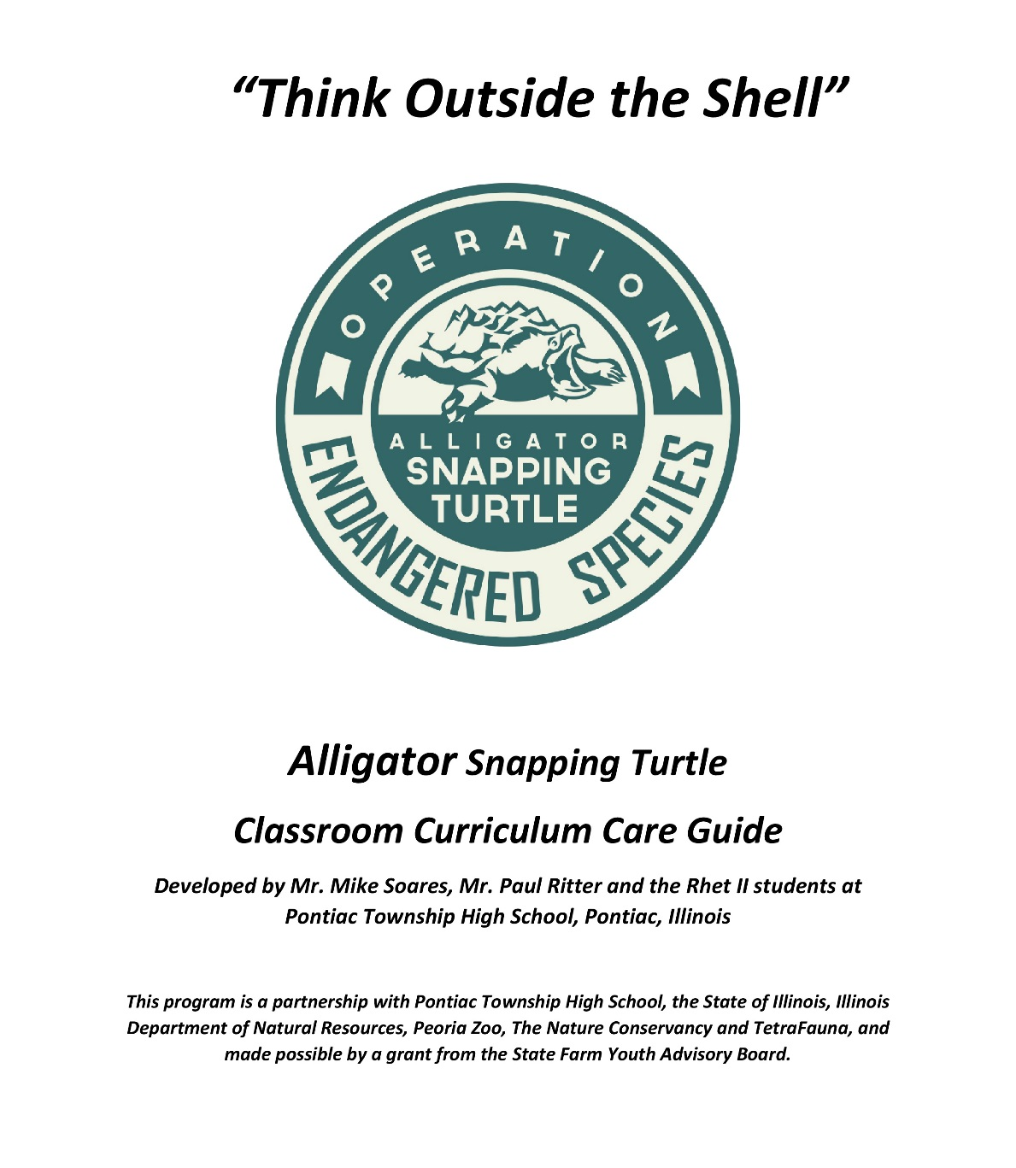
AST Care and Curriculum Guide

Slide 27
Other Classrooms
Civics – Proclamations, letters to legislators
House Resolution 1029 - May 18, 2012 designated
as Endangered Species Day in the State of Illinois
(with State Rep. Jason Barickman (R-Champaign).
Speech – PSA’s
Music Theory – Theme Songs
Art – Posters, sculptures

Slide 28
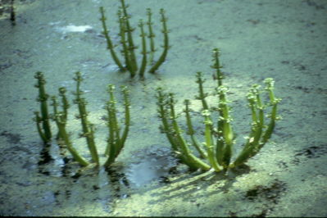
Beyond the Classroom
AST’s tagged and released by IDNR with students into the Cache Watershed (Southern IL)
Riends of the cache watershed
Photo from Friends of the Cache Watershed

Slide 29
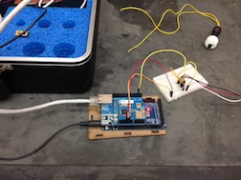
Whitney Young Magnet School
From the tank to the computer: sensors for water level, temperature, pH, and nitrate or nitrite levels
Source: news.medill.northwestern.edu/chicago/news.aspx?id=225953

Slide 30
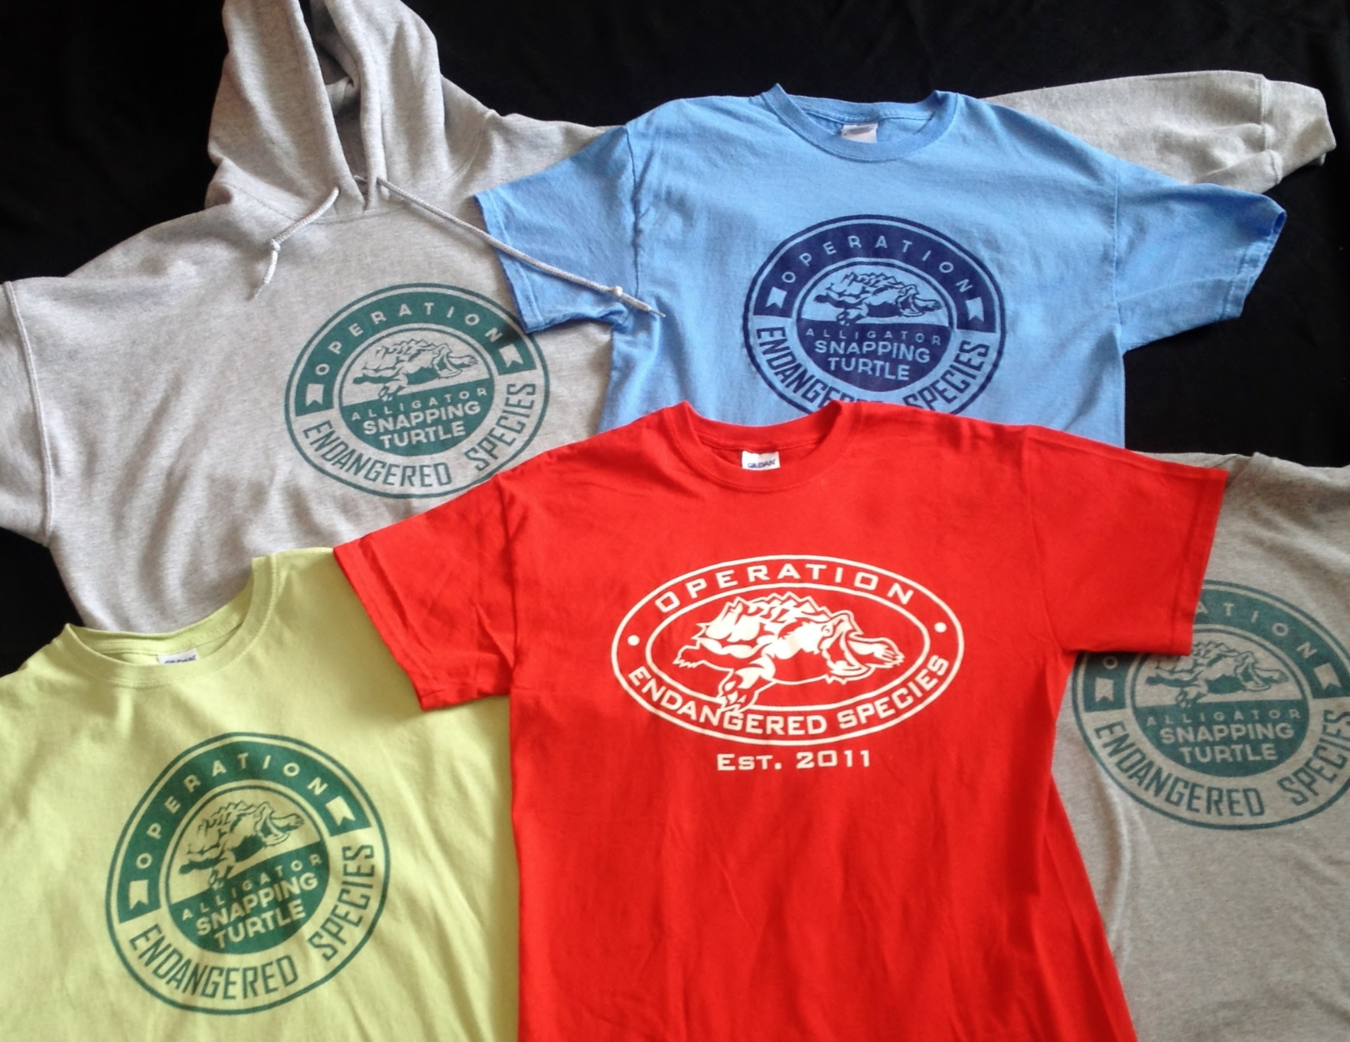
Products

Slide 31
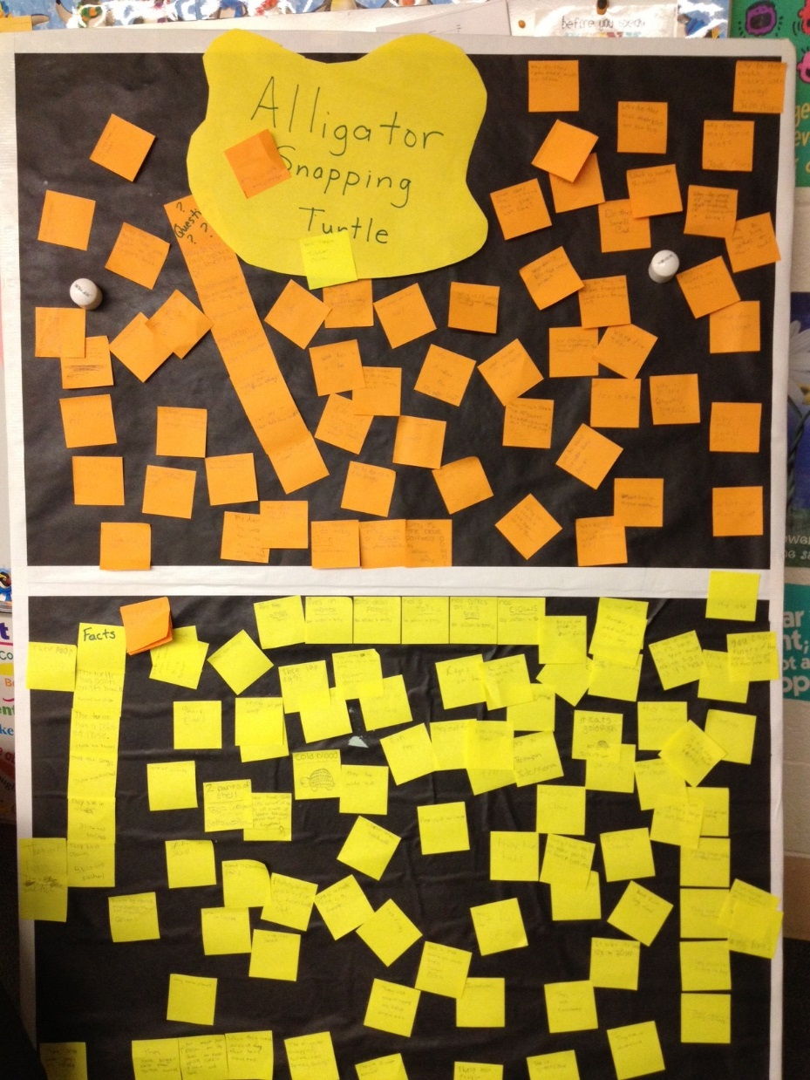
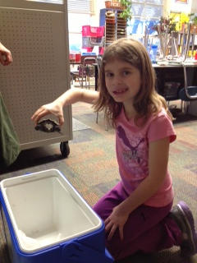
ISU Connection
Metcalf Laboratory School

Slide 32
Recovery Model
Proposal Summary:
“To expand Operation Endangered Species through creating species recovery modules for other Illinois state-listed Threatened & Endangered Species/Species in Greatest Need of Conservation which are tractable for high schools to adopt and permitted by the Illinois Department of Natural Resources.”
Source: Angelo Capparella, PhD., Associate Professor of Zoology,
School of Biological Sciences, Illinois State University

Slide 33
Final Quote
“Hands-on activities with animals in the classroom can literally change a kid’s life. I am a living, breathing example of that.”
Dr. Brady Barr, Resident Scientist
National Geographic

