Slide 1
Reflecting on Students’ Past & Expectations for the Future
Derek Herrmann & Ryan Smith
University Assessment Services
CTLT Annual Symposium - January 2016

Slide 2
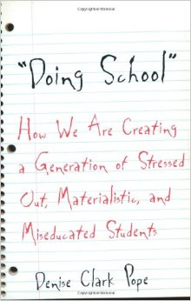
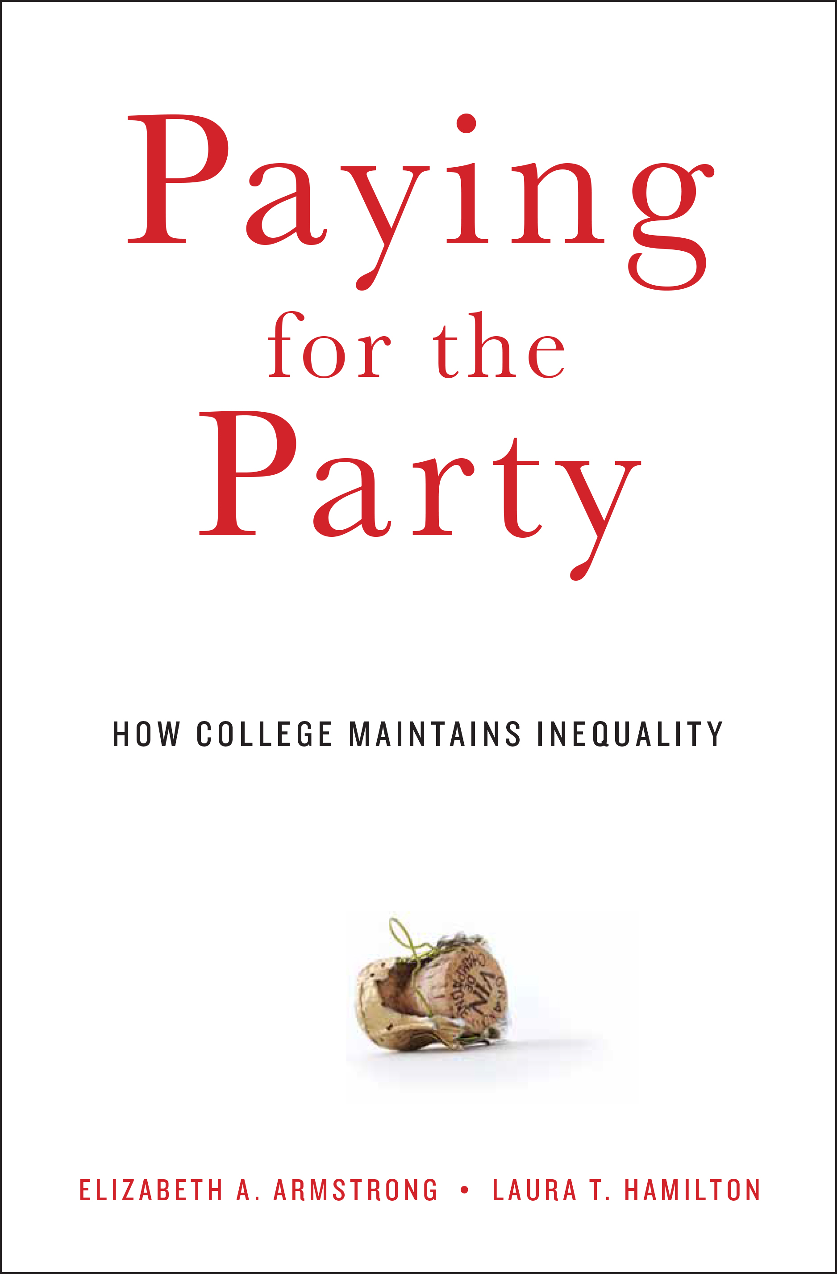
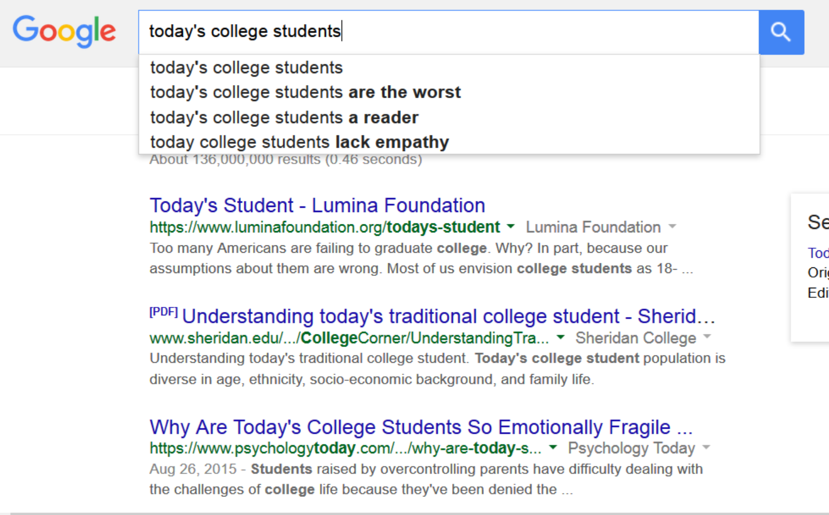
Narratives about Today’s New Students

Slide 3
Expectations
What students expect based on their best understanding of the past.

Slide 4
What Do We Need to Know?
Demographics
Academic background
Learning strategies
Interactions with other students & teachers
Expected academic perseverance
Expected academic & social challenges
Self-reported attitudes about preparation
Expected academic difficulty
Importance placed on campus environment

Slide 5
Ideas for Practice
Thing we can react to but can’t change – demographics, economy, etc.
Things we can influence – HS curriculum, guidance counselors and other ‘gatekeepers,’ institutional culture, etc.
Things we can control – curriculum, when students register, number of withdrawals, recognizing affective and cognitive learning, tapping into B+ and lower grade students’ motivation, etc.

Slide 6
What Do We Need to Know?
Demographics
Academic background
Learning strategies
Interactions with other students & teachers
Expected academic perseverance
Expected academic & social challenges
Self-reported attitudes about preparation
Expected academic difficulty
Importance placed on campus environment

Slide 7
See handout for background information about the survey

Slide 8
Finding 1. Students expect to spend more time on academic preparation in college than they did in their last year of high school.

Slide 9
Finding 2. Students expect college to be more challenging and requiring more preparation and work.

Slide 10
Finding 3. Students generally feel academically prepared for college. However, there are significant differences between A- or higher and B+ or lower students.

Slide 11
Finding 3. Students generally feel academically prepared for college. However, there are significant differences between A- or higher and B+ or lower students.

Slide 12
Finding 3. Students generally feel academically prepared for college. However, there are significant differences between A- or higher and B+ or lower students.

Slide 13
Finding 4. Students expect to struggle with managing time. Students also expect a collaborative and more diverse environment in college.

Slide 14
Finding 4. Students expect to struggle with managing time. Students also expect a collaborative and more diverse environment in college.

Slide 15
Finding 4. Students expect to struggle with managing time. Students also expect a collaborative and more diverse environment in college.

Slide 16
Student Portraits
New first-year students are confident about their academic ability. They expect college to be more challenging and require more work than high school. They also expect opportunities to engage with faculty and other students and to be involved in social and co-curricular events on campus. They are somewhat more apprehensive about managing their time and avoiding distractions. In most cases, over half of students report levels feeling prepared, overcoming general challenges, and overcoming difficulties.
New first-year students with grades of B+ and below, however, express more apprehension in terms of their academic ability and engaging with others on campus. These students express lower feelings of preparation in writing and analyzing numerical information, and learning on their own. Socially, these students are less confident in terms of participating in course discussions, managing their time, and being involved socially.
There were little differences by first-generation status, other than they expect to interact with faculty less than other students and expressed slightly less more expectation to encounter difficultly paying for college.

Slide 17
Future Research
Looking at the data by race/ethnicity, gender, and other categories.
Complimenting the survey with qualitative data
Longitudinal cohort tracking
Linking BCSSE 15 to NSSE 16 as a follow up to expectations
Momentum indicators
Mapping BCSSE and NSSE results
Others?

