Slide 1
Why Won’t They Read?! Encouraging Students to Engage in Reading
Pennie L. Gray
Educational Studies
Illinois Wesleyan University (and ISU Alum)

Slide 2
Invisible Reading
Reading is often overlooked (because it’s invisible):
Writing weaknesses are overt
Reading weaknesses are covert
Receptive Language
Expressive Language

Slide 3
Informal (Admittedly Unscientific) Poll of Instructors
How many pages of reading do you assign students per week?
On a scale from 1 to 10, how dense is the text you ask students to read?
What percentage of the reading do you think students complete?

Slide 4
Informal (Admittedly Unscientific) Poll of Students
How much of the assigned reading do you actually do?

Slide 5
Students
How much of the assigned reading do you actually do? It depends. . .
Depends on the class. In a literature class, like 90%.

Slide 6
Students
How much of the assigned reading do you actually do? It depends. . .
Depends on the class. In a literature class, like 90%.
Smaller chunks I will read, but if it’s too much, I just skim.

Slide 7
Students
How much of the assigned reading do you actually do? It depends. . .
Depends on the class. In a literature class, like 90%.
Smaller chunks I will read, but if it’s too much, I just skim.
More than four pages might be a skim unless it’s a really interesting.

Slide 8
Students
How much of the assigned reading do you actually do? It depends. . .
Depends on the class. In a literature class, like 90%.
Smaller chunks I will read, but if it’s too much, I just skim.
More than four pages might be a skim unless it’s a really interesting.
If it’s too much, you have consider your other obligations and prioritize what you do.

Slide 9
Students
How much of the assigned reading do you actually do? It depends. . .
Depends on the class. In a literature class, like 90%.
Smaller chunks I will read, but if it’s too much, I just skim.
More than four pages might be a skim unless it’s a really interesting.
If it’s too much, you have consider your other obligations and prioritize what you do.
An unmanageable amount is 110 pages a night; Even 20 is a lot of pages for one class, so more than that won’t get read.

Slide 10
Students
How much of the assigned reading do you actually do? It depends. . .
Depends on the class. In a literature class, like 90%.
Smaller chunks I will read, but if it’s too much, I just skim.
More than four pages might be a skim unless it’s a really interesting.
If it’s too much, you have consider your other obligations and prioritize what you do.
An unmanageable amount is 110 pages a night; Even 20 is a lot of pages for one class, so more than that won’t get read.
But some classes require you to read it thoroughly. 12 pages is OK, but after 10, I skim. If it’s dull, I won’t finish it.

Slide 11
Students
What can your professors do to encourage you to read?

Slide 12
Students
What can your professors do to encourage you to read?
Class discussion of readings (and a discussion grade)

Slide 13
Students
What can your professors do to encourage you to read?
Class discussion of readings (and a discussion grade)
Assign reading facilitators (Jigsaw)

Slide 14
Students
What can your professors do to encourage you to read?
Class discussion of readings (and a discussion grade)
Assign reading facilitators (Jigsaw)
“I don’t want to let the professors down.”

Slide 15
Students
What can your professors do to encourage you to read?
Class discussion of readings (and a discussion grade)
Assign reading facilitators (Jigsaw)
“I don’t want to let the professors down.”
“That’s what the first two weeks of class establish--how important it is to do the readings. Midterms can be a wake up call.”

Slide 16
Students
What can your professors do to encourage you to read?
Class discussion of readings (and a discussion grade)
Assign reading facilitators (Jigsaw)
“I don’t want to let the professors down.”
“That’s what the first two weeks of class establish--how important it is to do the readings. Midterms can be a wake up call.”
“It’s hard when there’s no alignment between what we’re reading and what we are talking about in class.”

Slide 17
Students
What can your professors do to encourage you to read?
Class discussion of readings (and a discussion grade)
Assign reading facilitators (Jigsaw)
“I don’t want to let the professors down.”
“That’s what the first two weeks of class establish--how important it is to do the readings. Midterms can be a wake up call.”
“It’s hard when there’s no alignment between what we’re reading and what we are talking about in class.”
“In some instances, we have to reread. Having guided notes or a pre-reading session before the reading would be helpful with denser readings.”

Slide 18
Students
What can your professors do to encourage you to read?
Discuss the readings in class (and a discussion grade)
Assign reading facilitators (Jigsaw)
“I don’t want to let the professors down.”
“That’s what the first two weeks of class establish--how important it is to do the readings. Midterms can be a wake up call.”
“It’s hard when there’s no alignment between what we’re reading and what we are talking about in class.”
“In some instances, we have to reread. Having guided notes or a pre-reading session before the reading would be helpful with denser readings.”
“It might help to have a glossary of certain terms before we read—pre-teaching might encourage students to do the reading because they have guidance and a structure to understand the readings.” (e.g., postmodern)

Slide 19
Results from (Admittedly Unscientific) Poll:
Students don’t complete readings due to:
Perceived lack of time
Lack of interest in the content
Not understanding the relevance of the content
Lack of disciplinary reading and literacy skills
When I asked, “How do you read differently in the various disciplines?” Crickets.
We can’t do anything about the first reason, but we might be able to do something about the other three.

Slide 20
Furthermore:
Students may not realize:
That reading well isn’t necessarily reading quickly;
That we change how we read depending on the discipline and genre;
That reading ten pages in one discipline is not the same as ten pages in a different discipline.
Text structure anecdote: What’s an edited text?

Slide 21
Vicious Cycle
Lecture over readings
Students don’t see need to read
Students skim readings
Students perceived as poor readers
Bean, 2008, p. 168

Slide 22
Overview
Disciplinary Literacy
Two Pronged Approach
Using strategies
Developing Mindfulness
My successes (and failures)
Resources
An assignment (for the particularly ambitious)
Questions/Comments

Slide 23
Disciplinary
Literacy
Intermediate Literacy
(fluency, more sophisticated comprehension, schema expansion, lexicon development)
Basic Literacy
(decoding + basic comprehension)
Shanahan and Shanahan, 2008, p. 44

Slide 24
Disciplinary
Literacy
Intermediate Literacy
Basic Literacy
More Specific,
Less Generalizable
Less Specific,
More Generalizable
Shanahan and Shanahan, 2008, p. 44

Slide 25
Disciplinary
Literacy
Intermediate Literacy
Basic Literacy
More Specific,
Less Generalizable
Less Instruction
Time
Reading is not inoculation.
More Instruction
Time
Less Specific,
More Generalizable
Shanahan and Shanahan, 2008, p. 44

Slide 26
Disciplinary Literacy Variances
Lexicon in the discipline: What vocabulary is used and how (e.g., plot)
Structure of an argument or rhetorical structure: What is compelling or persuasive?
Approach to truth or facts: What is known and how?
Relevance: What matters within the discipline and why?
Audience: Who cares?
Reading Strategy Variance:
Mathematics: close reading and re-reading
Chemistry: visualizing, writing down formulae, moving between graphs and charts and text
History: focus on author/source/date/bias
How much of this are we aware of?
How much of this do we teach students?
Disciplinary
Literacy
Shanahan, T. & Shanahan, C. (2008). Teaching disciplinary reading to adolescents: Rethinking content area literacy. Harvard Educational Review, 78(1), 40-59.

Slide 27
Disciplinary Literacy as a Gatekeeper
Disciplinary literacy is the vehicle by which a discipline advances knowledge, but it is also a gatekeeper that protects the hegemony of the discipline—a Discourse that keeps some in and some out (Gee).
How might we unveil for students how literacy functions within our disciplines to let them in?

Slide 28
What does our disciplinary reading look like to students?
Daniels, H., & Zemelman, S. (2004). Subjects matter: Every teacher’s guide to content-area reading. Portsmouth, NH: Heinemann.

Slide 29
Prong I: Disciplinary Reading Approaches
I’m proposing a two-pronged approach:
Prong I: Teach explicitly disciplinary reading strategies
Prong II: Teach metacognition so students know when those strategies are and are not working (i.e., mindful reading from Carillo, 2015)
Note: This is not about reading remediation for struggling readers—that’s a different presentation.

Slide 30
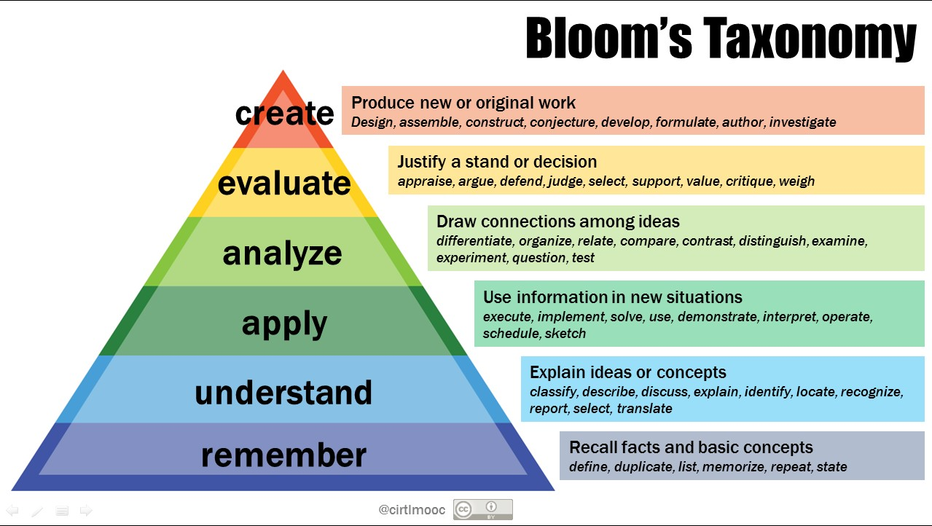
Awareness of Deep vs Surface Reading/Thinking
https://cft.vanderbilt.edu/wp-content/uploads/sites/59/Bloomtaxonomy.jpg
Roberts and Roberts in Bean, 2008.

Slide 31
What can you do?
Teach (explicitly) disciplinary literacy: thinking, reading, speaking, writing

Slide 32
What else can you do?
Teach (explicitly) disciplinary literacy: thinking, reading, speaking, writing
Consider developing a How to read like a(n) _________ handout for students (see Concepcion, 2004, for an example)

Slide 33
What else can you do?
Teach (explicitly) disciplinary literacy: thinking, reading, speaking, writing
Consider developing a How to read like a(n) _________ handout for students (see Concepcion, 2004, for an example)
Pre-teach: Predefine unknown terms and concepts

Slide 34
What else can you do?
Teach (explicitly) disciplinary literacy: thinking, reading, speaking, writing
Consider developing a How to read like a(n) _________ handout for students (see Concepcion, 2004, for an example)
Pre-teach: Predefine unknown terms and concepts
Set up a jigsaw

Slide 35
What else can you do?
Teach (explicitly) disciplinary literacy: thinking, reading, speaking, writing
Consider developing a How to read like a(n) _________ handout for students (see Concepcion, 2004, for an example)
Pre-teach: Predefine unknown terms and concepts
Set up a jigsaw
Set an active goal for the reading—what will they do with the content?
Participate in discussion
Facilitate discussion
Summarize
Contribute to the Message Board

Slide 36
What else can you do?
Help students understand the relevance of the reading.

Slide 37
What else can you do?
Help students understand the relevance of the reading.
Access prior knowledge (schema): How is this like that? Make connections.

Slide 38
What else can you do?
Help students understand the relevance of the reading.
Access prior knowledge (schema): How is this like that? Make connections.
Consider being more selective with readings: How much do they need to read?

Slide 39
What else can you do?
Help students understand the relevance of the reading.
Access prior knowledge (schema): How is this like that? Make connections.
Consider being more selective with readings: How much do they need to read?
Tell students how to approach each reading: Skim this part, study this part, review this part

Slide 40
What else can you do?
Help students understand the relevance of the reading.
Access prior knowledge (schema): How is this like that? Make connections.
Consider being more selective with readings: How much do they need to read?
Tell students how to approach each reading: Skim this part, study this part, review this part
Demonstrate how you read (e.g., varying reading rate, re-reading, asking questions, marking the text, taking notes, practicing self-awareness of comprehension--Daniels and Zemelman, 2004, pp. 24-25)

Slide 41
What else can you do?
Help students understand the relevance of the reading.
Access prior knowledge (schema): How is this like that? Make connections.
Consider being more selective with readings: How much do they need to read?
Tell students how to approach each reading: Skim this part, study this part, review this part
Demonstrate how you read (e.g., varying reading rate, re-reading, asking questions, marking the text, taking notes)
Dissect an article together in class

Slide 42
What else can you do?
Help students understand the relevance of the reading.
Access prior knowledge (schema): How is this like that? Make connections.
Consider being more selective with readings: How much do they need to read?
Tell students how to approach each reading: Skim this part, study this part, review this part
Demonstrate how you read (e.g., varying reading rate, re-reading, asking questions, marking the text, taking notes)
Dissect an article together in class
Teach signal words (e.g., therefore, however, in fact, still)

Slide 43
What else can you do?
Help students understand the relevance of the reading.
Access prior knowledge (schema): How is this like that? Make connections.
Consider being more selective with readings: How much do they need to read?
Tell students how to approach each reading: Skim this part, study this part, review this part
Demonstrate how you read (e.g., varying reading rate, re-reading, asking questions, marking the text, taking notes)
Dissect an article together in class
Teach signal words (e.g., therefore, however, in fact, still)
Create curiosity (see Bean, p. 172)

Slide 44
What can students do?
Create concept map as they read showing relationships between concepts
Clicks/Clunks (What clicked and what clunked in the reading?)
Before and After (Have students record what they think the reading might be about before they read and then record their new understandings)
What It Says and What It Does: Students keep two columns for each paragraph or section telling what the section says (summary) and what it does (function) (McGraw Center on Teaching and Learning and Bean, p. 170)

Slide 45
What can students do?
Pose their own questions prior to reading, individually or as a class
KWLQ (Know/Wonder/Learned/Questions that remain)
Before/After/Outcome: (see Bean, p. 174)
Before I read this, the author assumed I. . .
After I read this, the author wanted me to believe. . .
The author was/was not successful in changing my view
Maintain a Google Doc with key questions they respond to as they read (or after reading as class discussion).

Slide 46
Prong II: Mindful Reading & Metacognition
New interest in and research into reading as part of the work of writing centers
See Pedagogy’s January 2016 issue (Adams, Carillo, Kalbfleisch, Lockhart & Soliday)
Writing tutors often have to refer back to readings to help students with their writing
Recall: receptive language precedes expressive language

Slide 47
Mindful reading & Metacognition
Carillo advocates for students to be “knowledgeable, deliberate, and reflective about how they read and the demands that contexts place on their reading” (emphasis added, p. 11).
Mindful reading “describes a particular stance on the part of the reader, one that is characterized by intentional awareness of and attention to the present moment, its context, and one’s perspective” (p. 11).
Knowledgeable: Know the strategies that are available to them
Deliberate: Use intentionally those strategies
Reflective: Practice awareness of the effectiveness of those strategies

Slide 48
Teaching Mindfulness & Metacognition
Reading rhetorically (Bean):
1. What questions does the text address, explicitly or implicitly?
2. Who is the intended audience?
3. How does the author support his or her thesis with reasons and evidence?
4. How does the author hook the intended reader’s interest and keep the reader reading?
5. How does the author make himself or herself seem credible to the intended audience?
6. Are this writer’s basic values, beliefs, and assumptions similar to or different from my own?
7. How do I respond to this text?
8. How do this author’s evident purposes for writing fit with my purposes for reading? (10)
However, we must also know when these questions or strategies are no longer working. How? Through mindfulness (Carillo pp. 12-13).

Slide 49
Teaching Mindfulness & Metacognition
Reading Journals (Carillo, 2016, p. 19):
Which reading approach will I employ first and why?
How far does this reading approach take me?
What does this reading approach allow me to notice in the text?
What must I ignore?
What meanings does this approach allow me to construct and what meanings does it prohibit?
And then:
At what point in the reading and why did I need to abandon my initial approach?
Why did the initial approach take me only so far?
What does this tell me about the approach, as well as about me as a reader?
What other approaches do I need to bring into play in order to construct a meaning that achieves the goals associated with my reading/writing assignment?
To what extent might this reading experience be useful as I read texts in my other courses? (Transfer)

Slide 50
Adams’ reading inventory (p. 84)
I enjoy reading (check all that apply):
I struggle or avoid reading (check all that apply):
Before I read for a course, I (check all that apply):
While I read for a course, I:
When I come across an unfamiliar word or phrase, I:
After I read something for a course, I:
On average, it takes me _____ to read a typical book chapter or article (25 pages):
I believe good readers:
What jumps out at me about my own reading:
Developed for Writing Tutors, but would be useful for all students to raise mindfulness and metacognition.

Slide 51
Stanger-Hall, 2012, p. 297

Slide 52
Why reading?
If we’re not teaching how to read in the disciplines, we’re missing a perfect opportunity to teach how to write in the disciplines.
Receptive Language
Expressive Language
In the disciplines
In the disciplines

Slide 53
What I’ve tried . . . with some success.
Building schema prior to reading;
Previewing readings (pointing out relevant features like date, author, structure);
Pre-defining terms (including morphology);
K-W-L-Q;
Student-facilitated discussions;
Student-submitted readings with rationale and vetting process;
Clicks and Clunks;
Jigsaws;
Edited readings (pointing out what sections to read carefully);
Situated readings within larger conversation.
I still have a long way to go, though!
I haven’t tried creating mindfulness yet.

Slide 54
Two Prongs: Both Necessary
Teaching Disciplinary Reading
Teaching Mindfulness & Metacognition

Slide 55
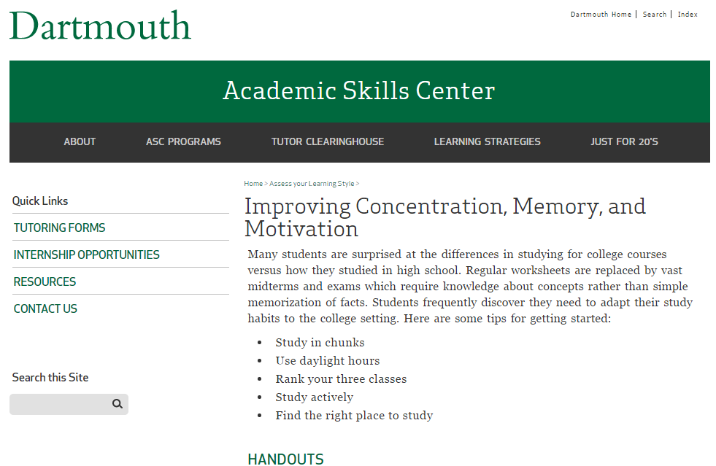
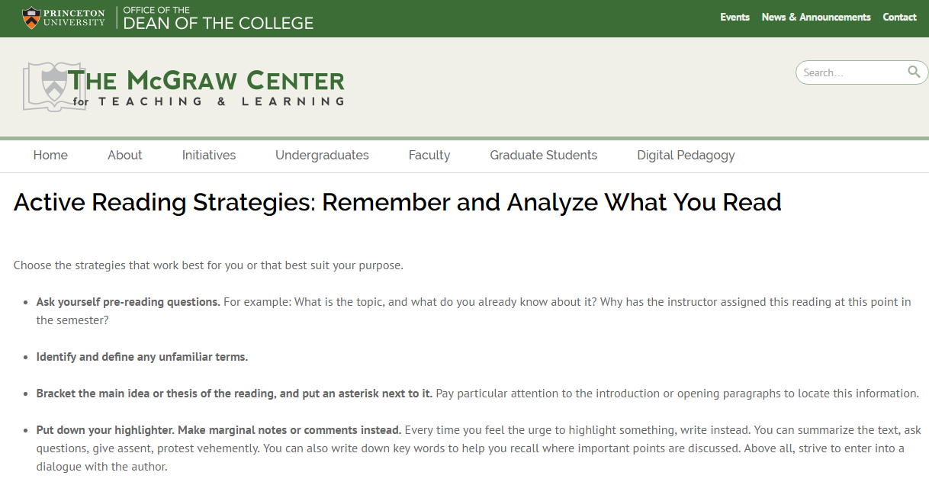
Resources
Dartmouth Academic Skills Center
Vanderbilt on Metacognition
Princeton McGraw Center for Teaching and Learning

Slide 56
References (and worthwhile readings)
Adams, G. T. (2016). The line that should not be drawn: Writing centers as reading centered. Pedagogy, 16(1), 73-90.
Bean, J. C. (2011). Engaging ideas: The professor’s guide to integrating writing, critical thinking, and active learning in the classroom. San Francisco, CA: Jossey-Bass.
Carillo, E. C. (2016). Creating mindful readers in first-year composition courses: A strategy to facilitate transfer. Pedagogy, 16(1), 9-22.
Concepcion, D. W. (2004). Reading philosophy with background knowledge and metacognition. Teaching Philosophy, 27(4), 351-368.
Daniels, H., & Zemelman, S. (2004). Subjects matter: Every teacher’s guide to content-area reading. Portsmouth, NH: Heinemann.
Fang, Z., and Schleppegrell, M. J. (2010). Disciplinary literacies across content areas: Supporting secondary reading through functional language analysis. Journal of Adolescent and Adult Literacy, 53(7), 587-597.
Kalbfleisch, E. (2016). Imitatio reconsidered: Notes toward a reading pedagogy for the writing classroom. Pedagogy, 16(1), 39-51.
Katalayi, G. B., and Sivasubramaniam, S. (2013). Careful reading versus expeditious reading: Investigating the construct validity of a multiple-choice reading test. Theory and Practice in Language Studies, 3(6), 877-884.
Lockhart, T., & Soliday, M. (2016). The critical place of reading in writing transfer (and beyond): A report of student experiences. Pedagogy, 16(1), 23-37.
Shanahan, T. & Shanahan, C. (2008). Teaching disciplinary reading to adolescents: Rethinking content area literacy. Harvard Educational Review, 78(1), 40-59.
Stanger-Hall, K. F. (2012). Multiple-choice exams: An obstacle for higher-level thinking in introductory science classes. Life Sciences Education, 11, 294-306.

Slide 57
If you’re feeling ambitious: Choose a reading. . .
Anticipate student struggles such as:
Lexicon: Will they know the words and how they’re used? (nominalization)
Background knowledge: What should they already know to understand the reading?
Prior Knowledge: How is this reading similar to or different from something else?
Relevance: Why is this important?
Context: What contextual factors matter (e.g., date, author, perspective, agenda, bias)?
Arguments/Counter-arguments: Where is this reading situated in the broader disciplinary narrative? (Burke’s parlor analogy)
Deep vs Surface Reading: What should they read deeply and what should they surface read (or not read at all)?
Graphic Input: Are there charts, graphs, illustrations to study?
Application: How will students use the reading?
Redesign a reading assignment and set up structure for students to monitor their own comprehension.

Slide 58
Questions or Comments?

